Slide 1
FFGC DISTRICT TOUR
OCTOBER 2023

Slide 2
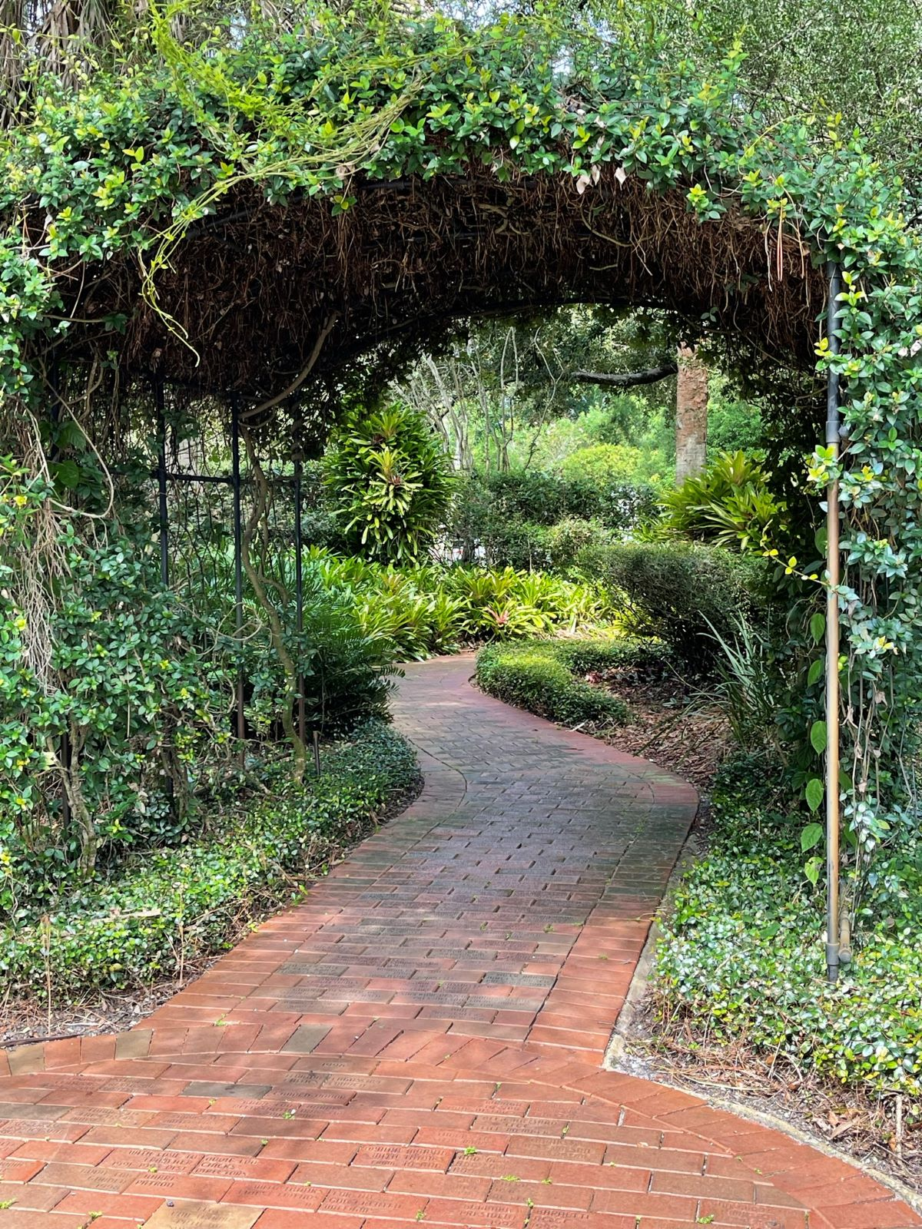
YOUR FFGC EXECUTIVE BOARD
Celebrating 100 Years
Tina Tuttle
President
Christy Linke
First Vice President
Mary Whisler
Second Vice President
Leticia Gunn
Third Vice President

Slide 3
FFGC MISSION STATEMENT
Notes:
All

Slide 4
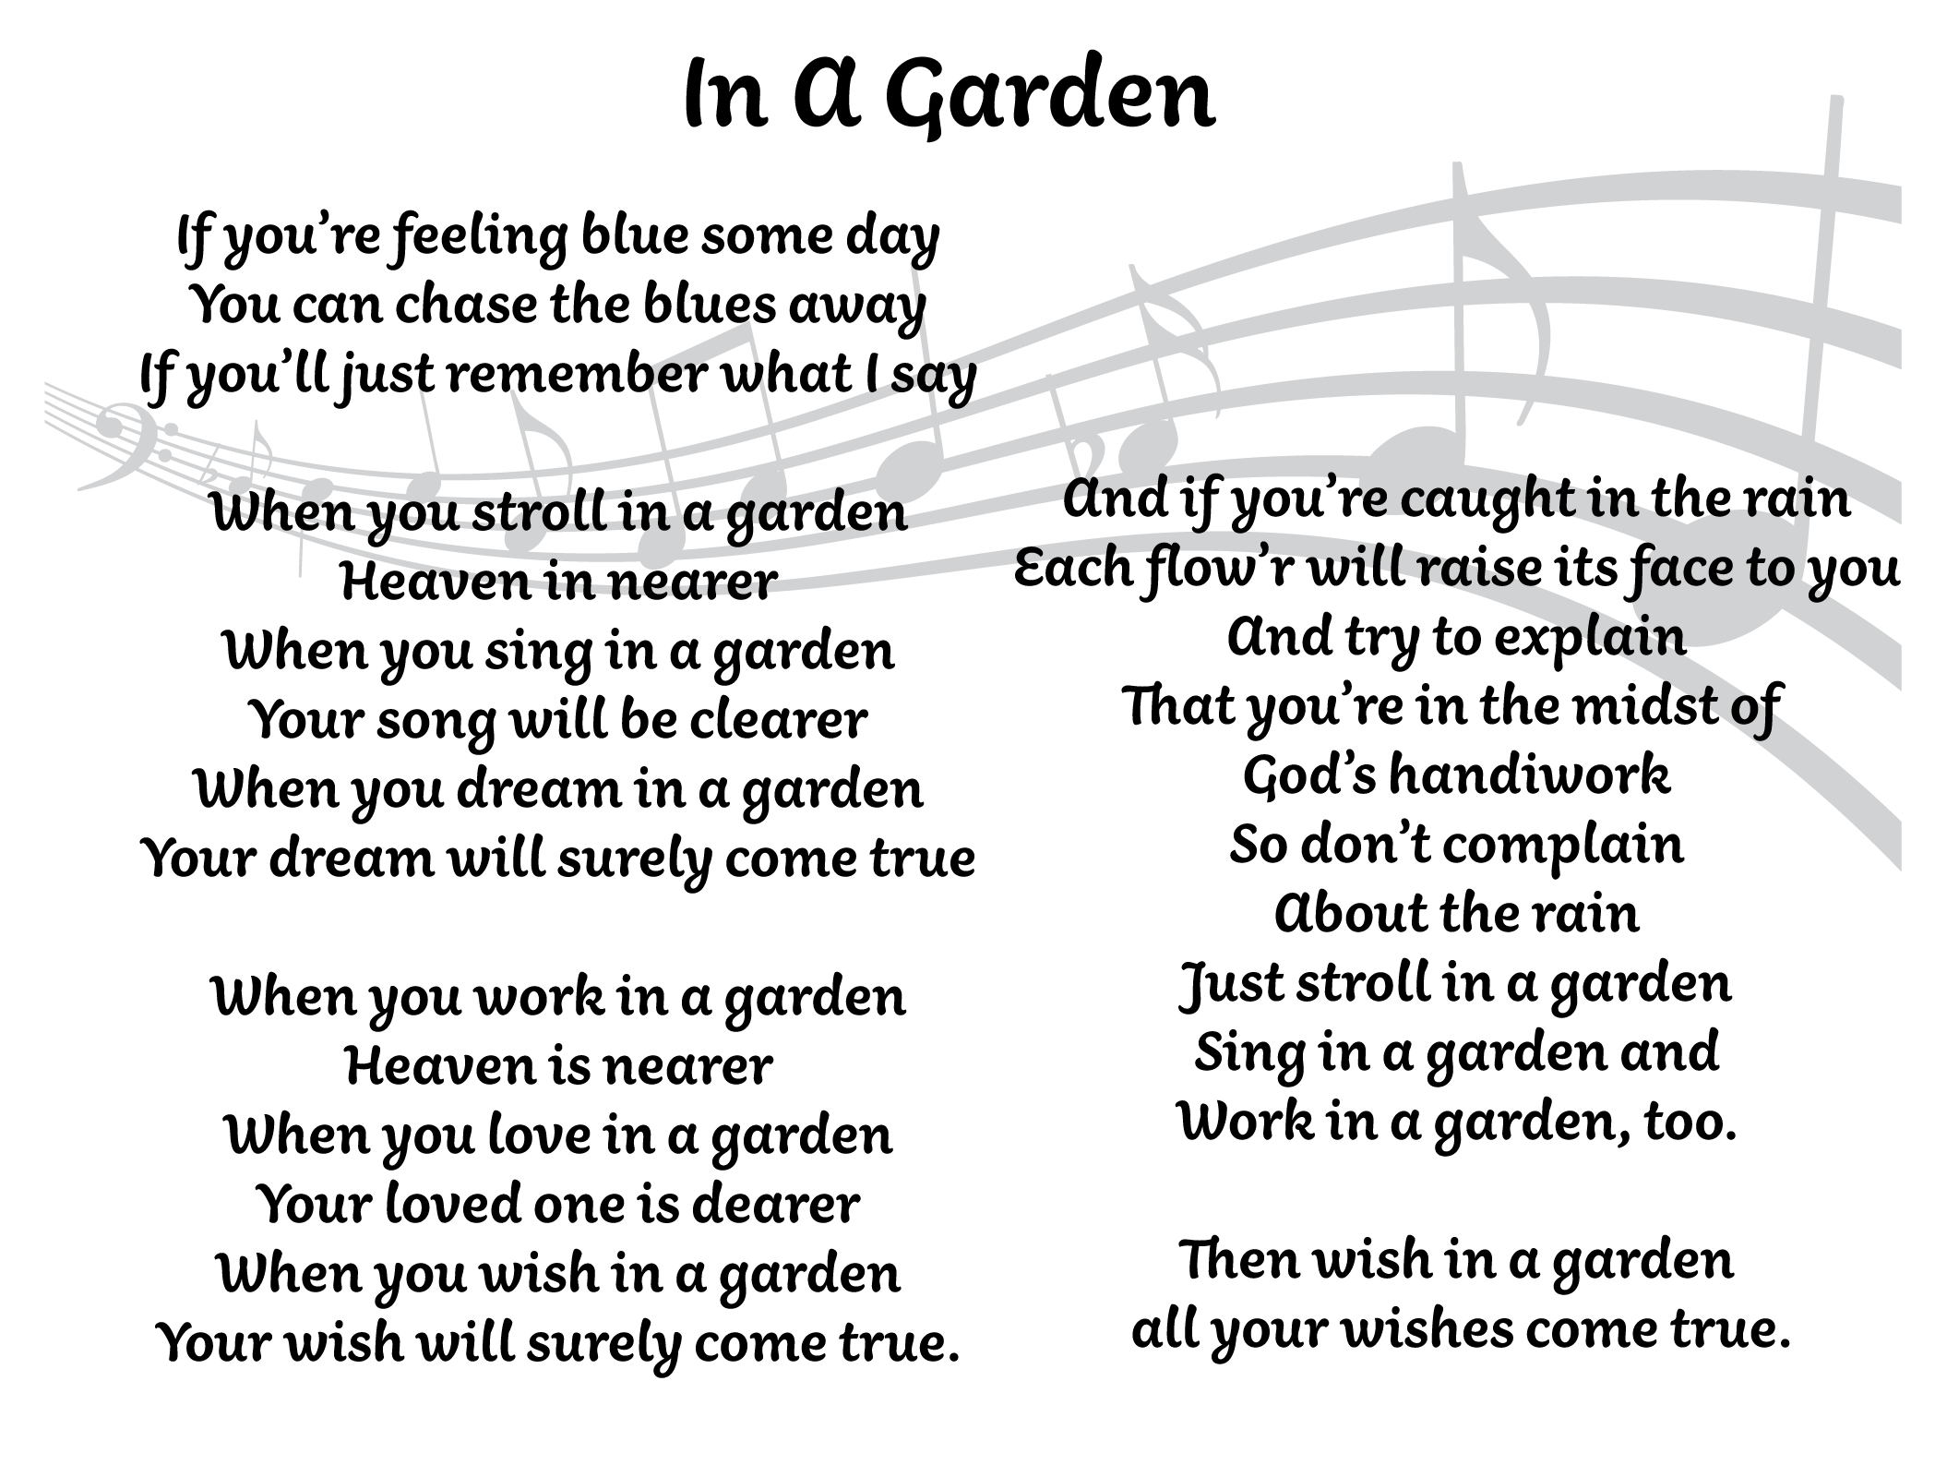
FFGC SONG
Notes:
All

Slide 5
F.F.G.C. NEWS & UPDATES
Headquarters Office Manager: Robin Hayes
Mon-Thurs 9 am - 1 pm EST
Email: ffgc@ffgcmail.com, www.ffgc.org Telephone: 407-647-7016
Legal issue with City of Winter Park “quashed.”
Dues are due May 1 and delinquent June 1.
The Florida Gardener is now online only!
BOI is online only with updates made monthly.
New State Newsletter-- all Districts participating.
Online Member Survey coming soon!
Open positions on the FFGC Board of Directors!

Slide 7
FFGC AND NGC GRANTS
Worthy Projects/new or ongoing.
a) Any activity aimed at increasing membership by welcoming interested individuals to your Club/Circle.
b) An activity to beautify your community
c) Any activity to increase awareness of our mission.
Grant funds must be spent by April of the following year awarded and a report with pictures sent to the FFGC Matching Grants Chairman, Helen Purvis.
There will be a $5,000 cap placed on grants awarded annually.
NGC’s Plant America grant from Ames Tools, Espoma, Native Plants and Wildflowers, and
Youth Pollinator Garden grants and Natural Disasters Program!

Slide 8
Notes:
Tina

Slide 9
#61 Nell Coe Award
“100 Ways to Celebrate 100 Years”
Description and Purpose: presented to encourage and promote participation in all aspects of FFGC and garden club work and boost the growth in our membership. We will be DOING garden club instead of just being a garden club.
Proof of Accomplishment: Apply, get proof of each activity, and email with pictures.
Award: $250 may be awarded in each category.
Submission: Email Award #61 to Tina Tuttle
Due Date: March 20, 2025
Notes:
Tina

Slide 10
AWARDS
All Award information is available online.
Applications sent via email but BOEs by mail.
Due dates differ—most due 22 November but several are due before or after that date!
#11 Yearbook Award ……………………………………………. November 1
Flower Show Achievement Awards ……………………....... November 22
Flower Show Related Awards ……………………………........November 22
Deep South & NGC Awards to Awards Chair ……………. November 22
Jr. Gardener FFGC Awards J-1 - J-6 …………………………..November 22
Nell Coe Award #61…………………………………………………March 20, 2025
Winners announced at convention.
Remember, you must enter to win!

Slide 11
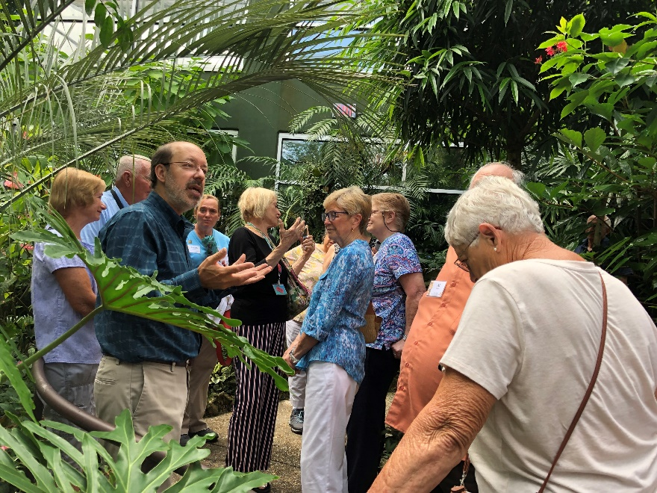
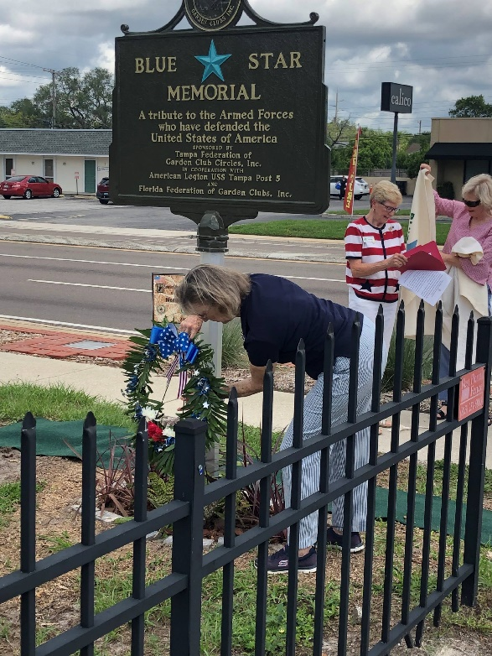
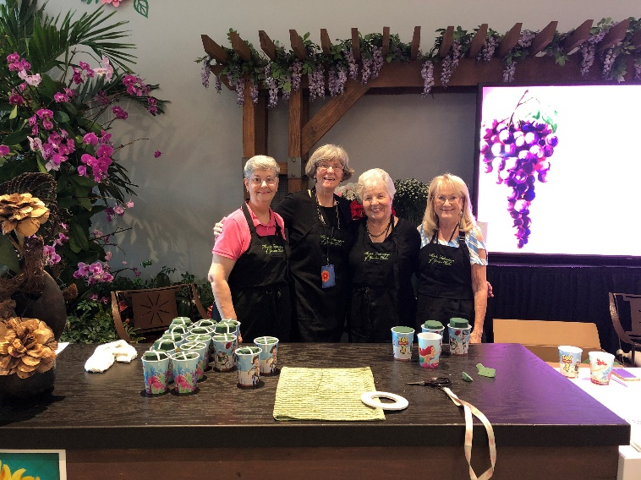
MEMBERSHIP
A.D.D. as District Membership Chair
Recruitment ideas! Retention ideas!
Membership cards distributed today!
Notes:
christy

Slide 12
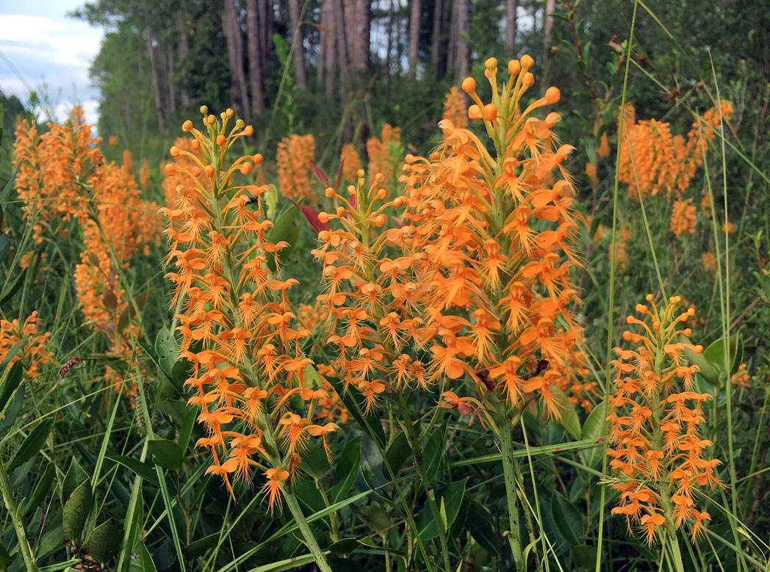
THE VALUE OF MEMBERSHIP
Membership connects you with nearly 10,000 members.
The Florida Gardener online and submit articles.
Educational workshops the environment, conservation, landscape design, and floral arranging. Complete all four NGC courses and become a recognized Consultant in that area.
Programming that educates you and others.
Convention for statewide presentations, speakers, education, and networking.
Awards for yourself or your club.
Earn an Honor through your club through special achievement, dedication or service.
Engage at the state level by leading a committee or climb the ladder from president to district director.
Notes:
christy

Slide 13
YOUR $12 MEMBERSHIP…
NGC Dues and Expenses $1.20
Board Expenses $0.40
The Florida Gardener $1.80
Awards $0.90
Staff & Office Expenses $3.40
Officer Expenses (+ Tour) $1.90
Website, Telephone & Web $0.70
FFGC Promotion/Membership
Cards $0.35
Contingency Fund $1.35
Annual Dues $12.00
Notes:
Christy

Slide 14
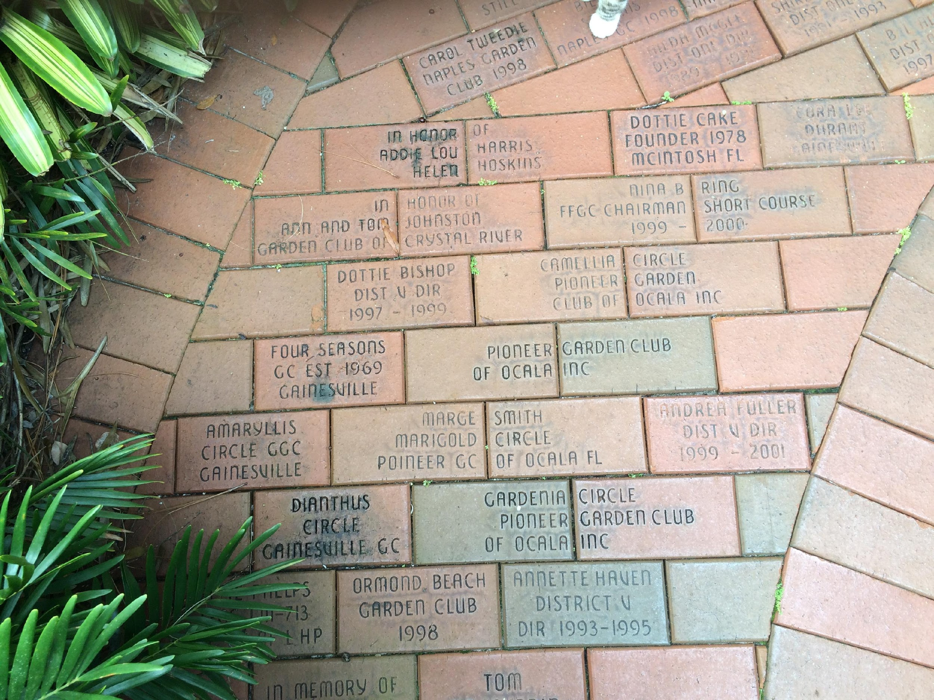
FFGC PERSONAL HONORS
FFGC PERSONAL HONORS
Bricks $50
Hall of Fame $100
Pillar of Pride $100
Earth Steward $100
Patron $500
Guardian of Gardening $1,500
Life memberships*
Notes:
Tina

Slide 15
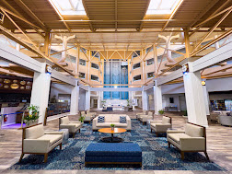
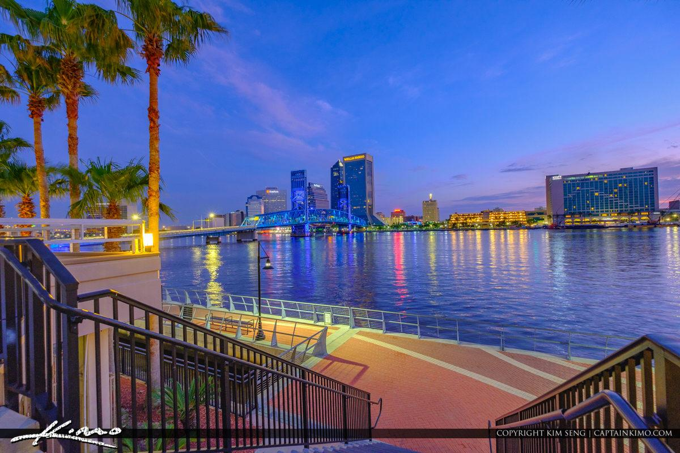
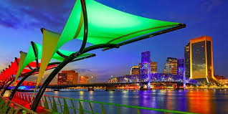
FFGC CONVENTION
“Celebrating 100 Years”
Date: April 9-12, 2024
Location: Jacksonville, FL
Hotel: Southbank by Marriott
100th Celebration
Biennial State Flower Show!
Awesome speakers and workshops!
Members Only Art Show with cash prizes!
Opportunity drawings, 50/50, and Tombola!
Notes:
Tina

Slide 16
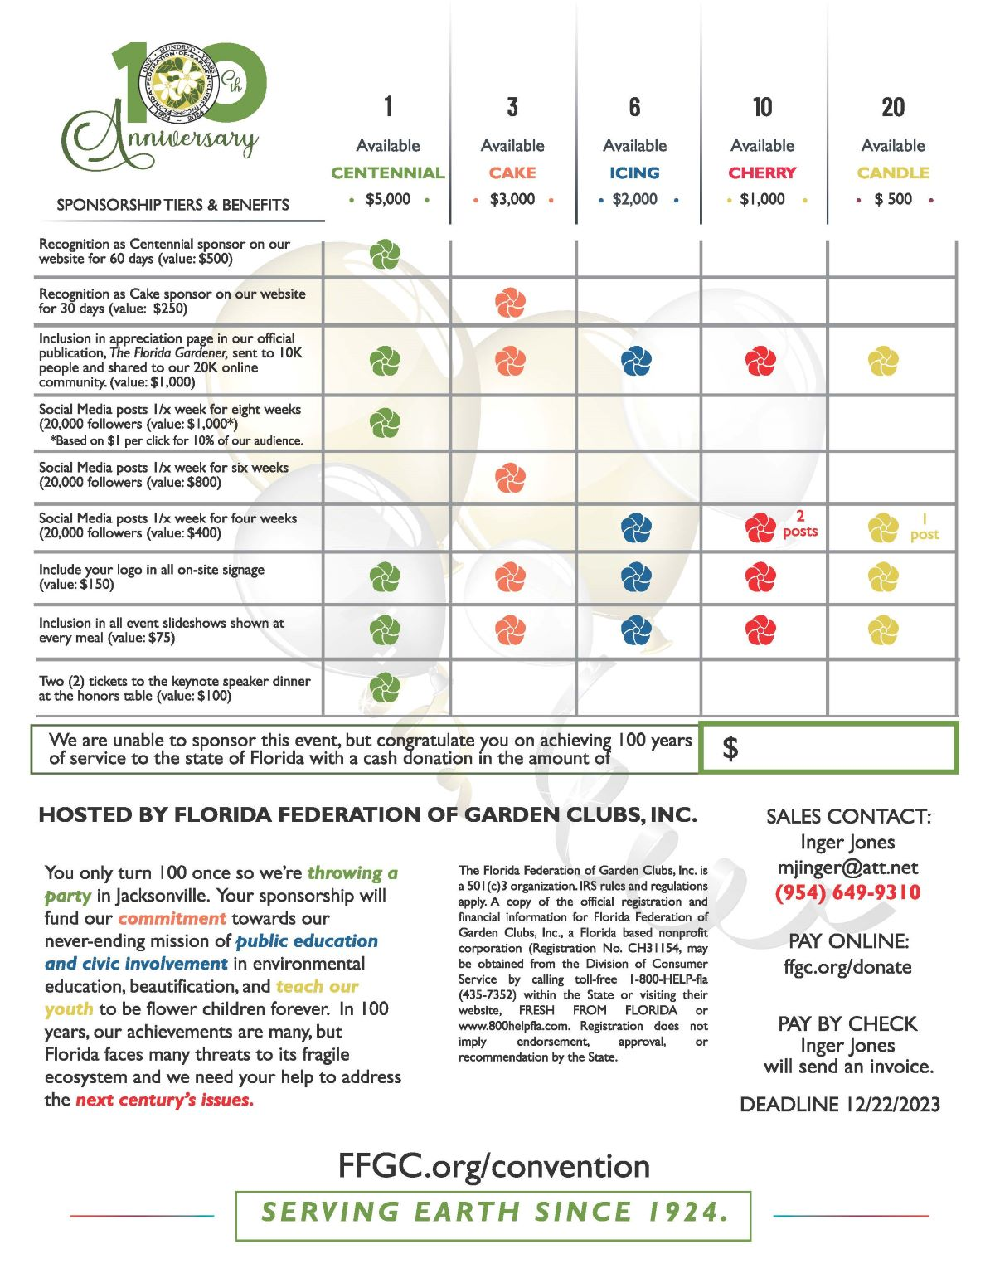
SPONSORSHIP
Only 40 convention sponsorships available!
Deadline: December 22, 2023.
Convention ads are available to, individuals clubs/circles, districts. $50 for half slide
$100 for full slide.
Deadline: February 21, 2024
Sponsor logos and convention ads will be featured
on PowerPoint during
meals.
Notes:
Tina

Slide 17
OPPORTUNITY DRAWING
FABULOUS PRIZES TO WIN!
Drawing will be at the convention on April 12,
2024.
You do not have to be
present to win …
but it would be so much fun if you were!
Notes:
Tina

Slide 18
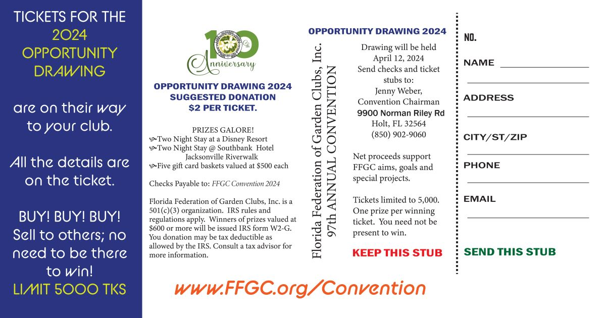
Fabulous prizes are waiting for you! All you have to do to WIN is purchase a ticket—or 2 or 3! Drawing for these prizes will be at convention on April 12, 2024.
Notes:
Tina

Slide 19
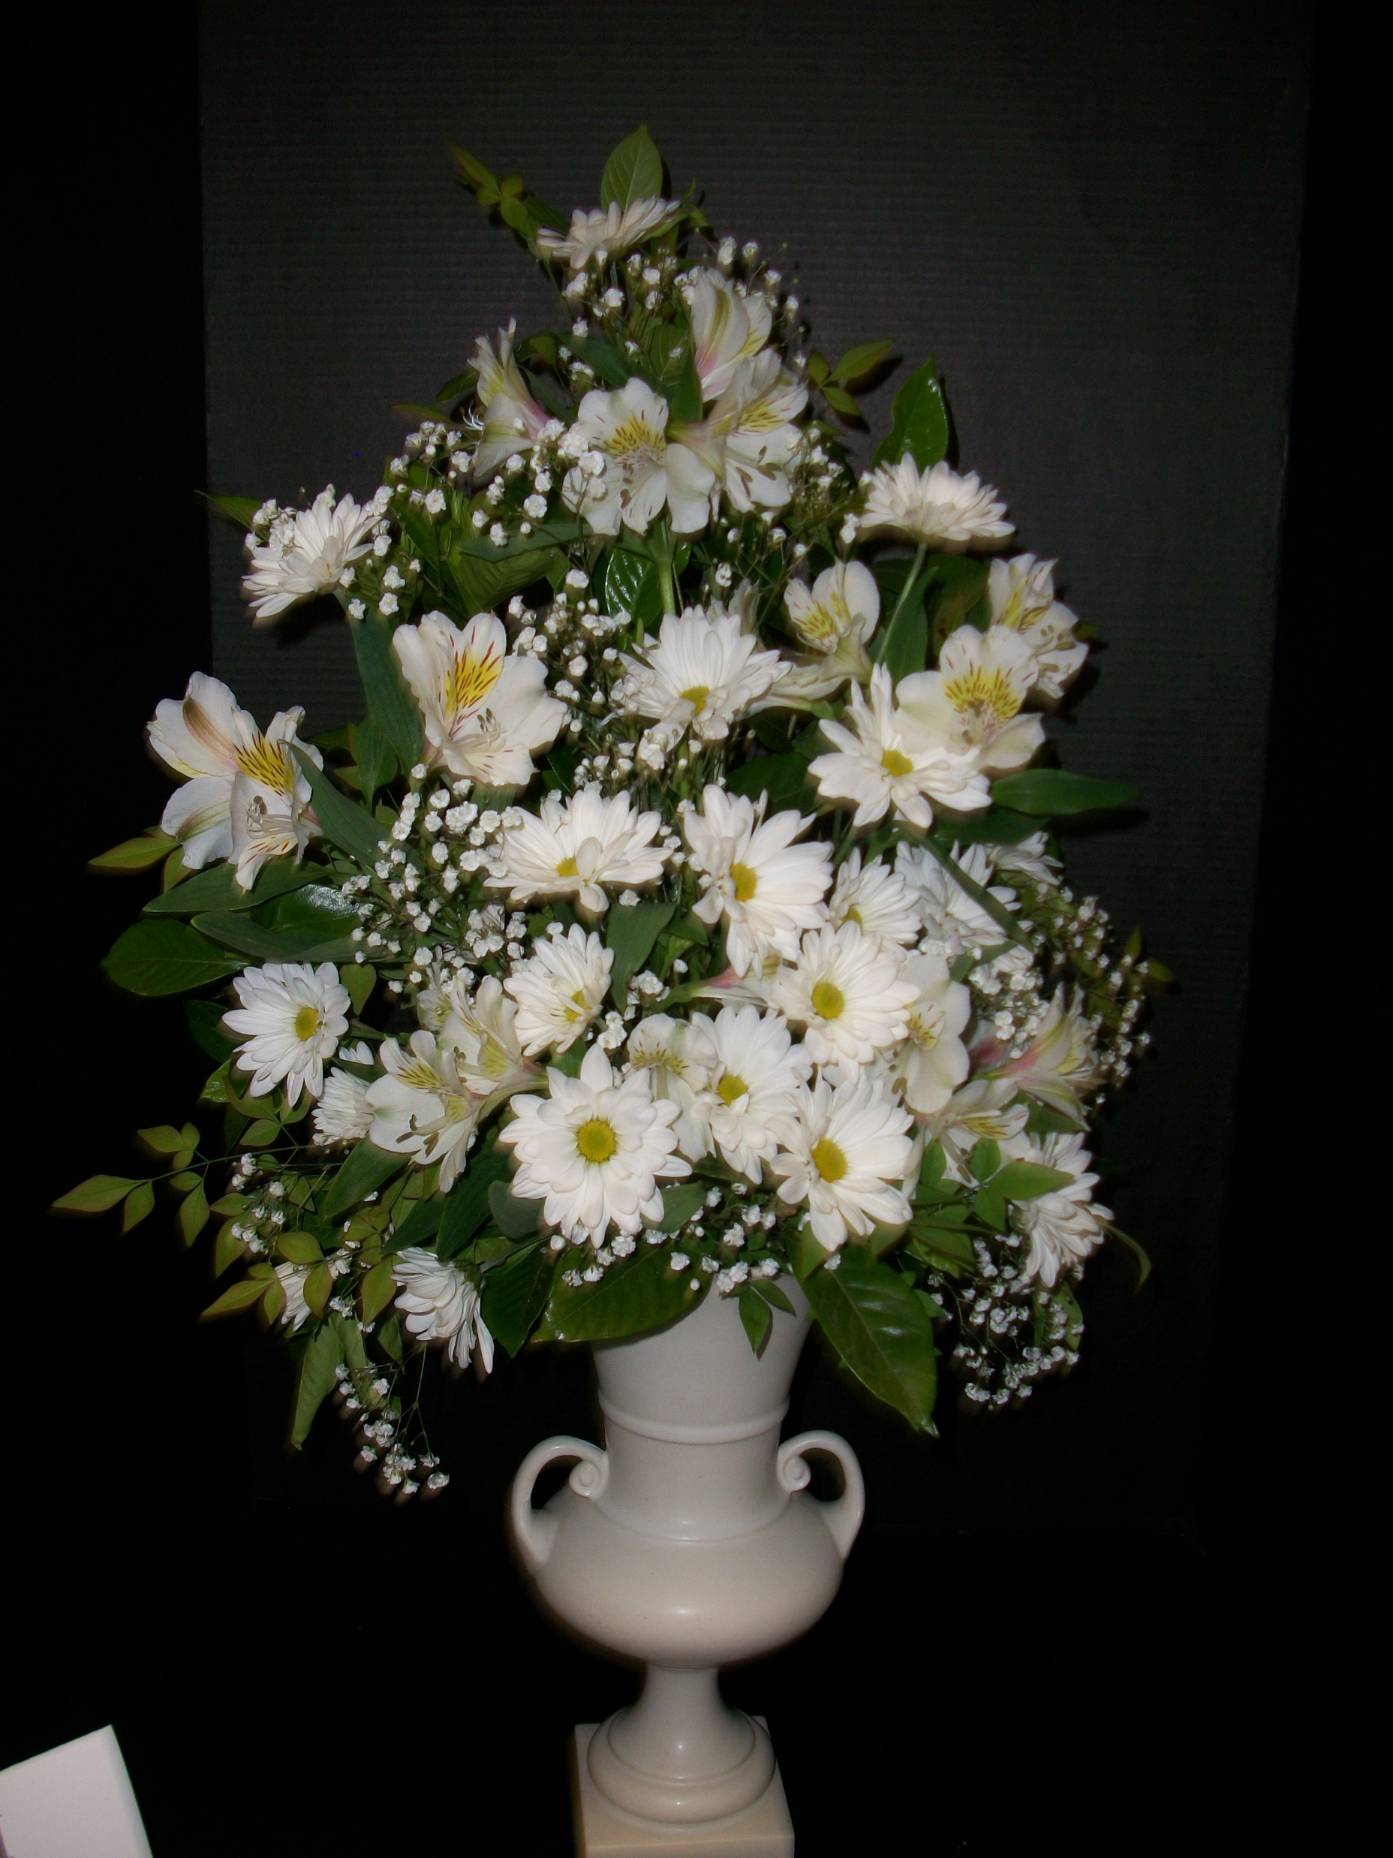
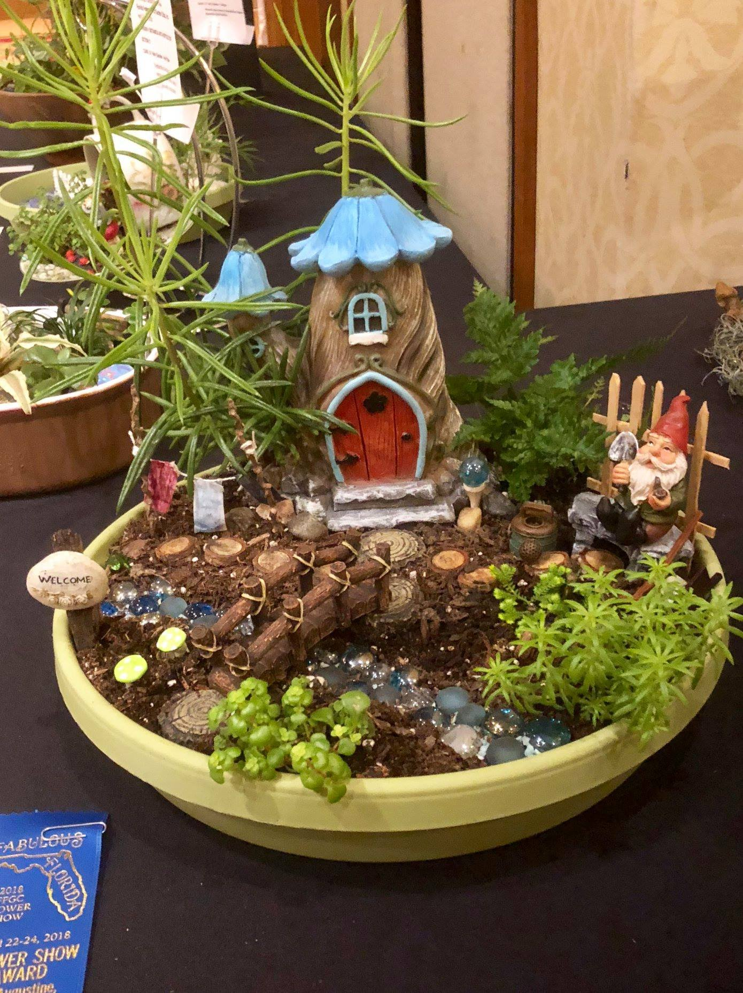
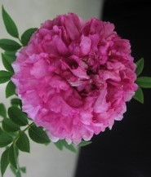
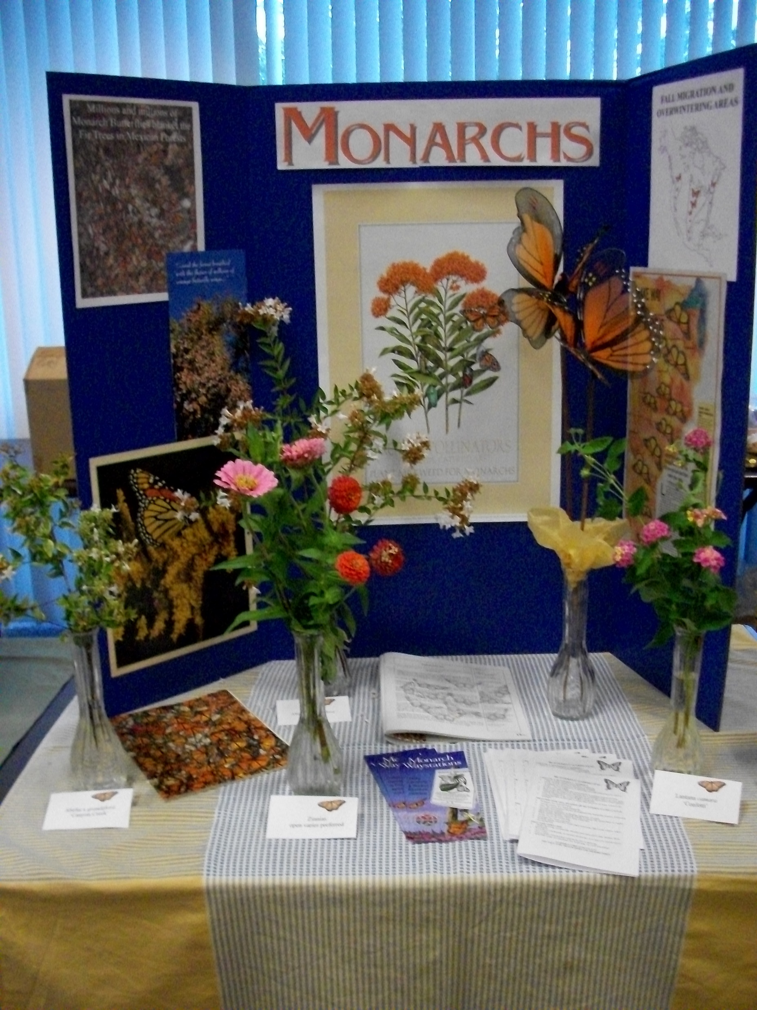
THE BIENNIAL STATE FLOWER SHOW
“CELEBRATING 100 YEARS!”
The Garden Club of Jacksonville on April 9-12, 2024
HORTICULTURE / DESIGNS / BOTANICAL ARTS / EDUCATIONAL EXHIBITS / YOUTH / VENDORS
Gina, Jogan, Chair

Slide 20
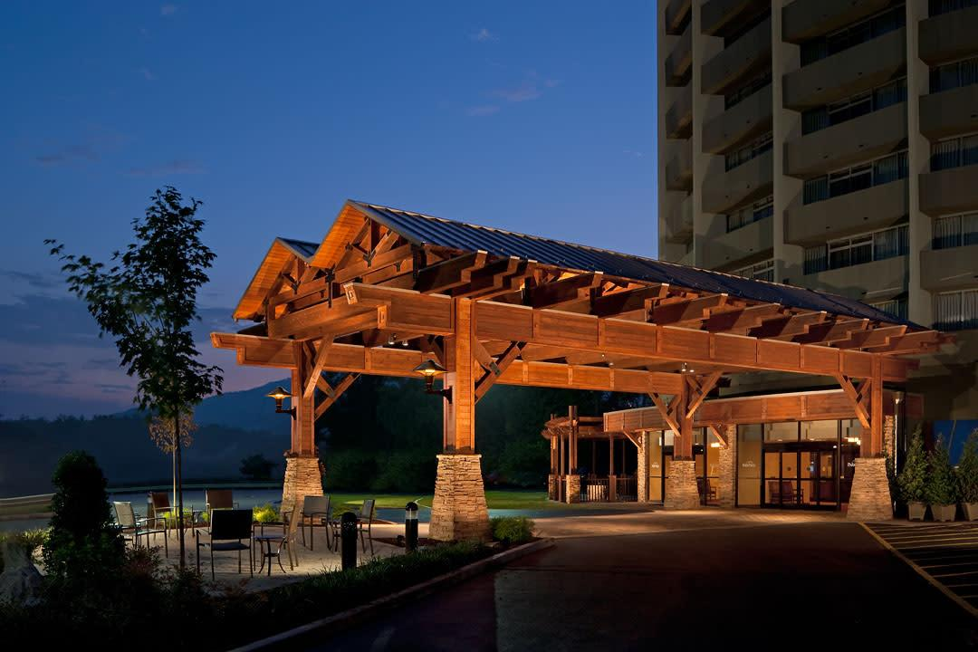
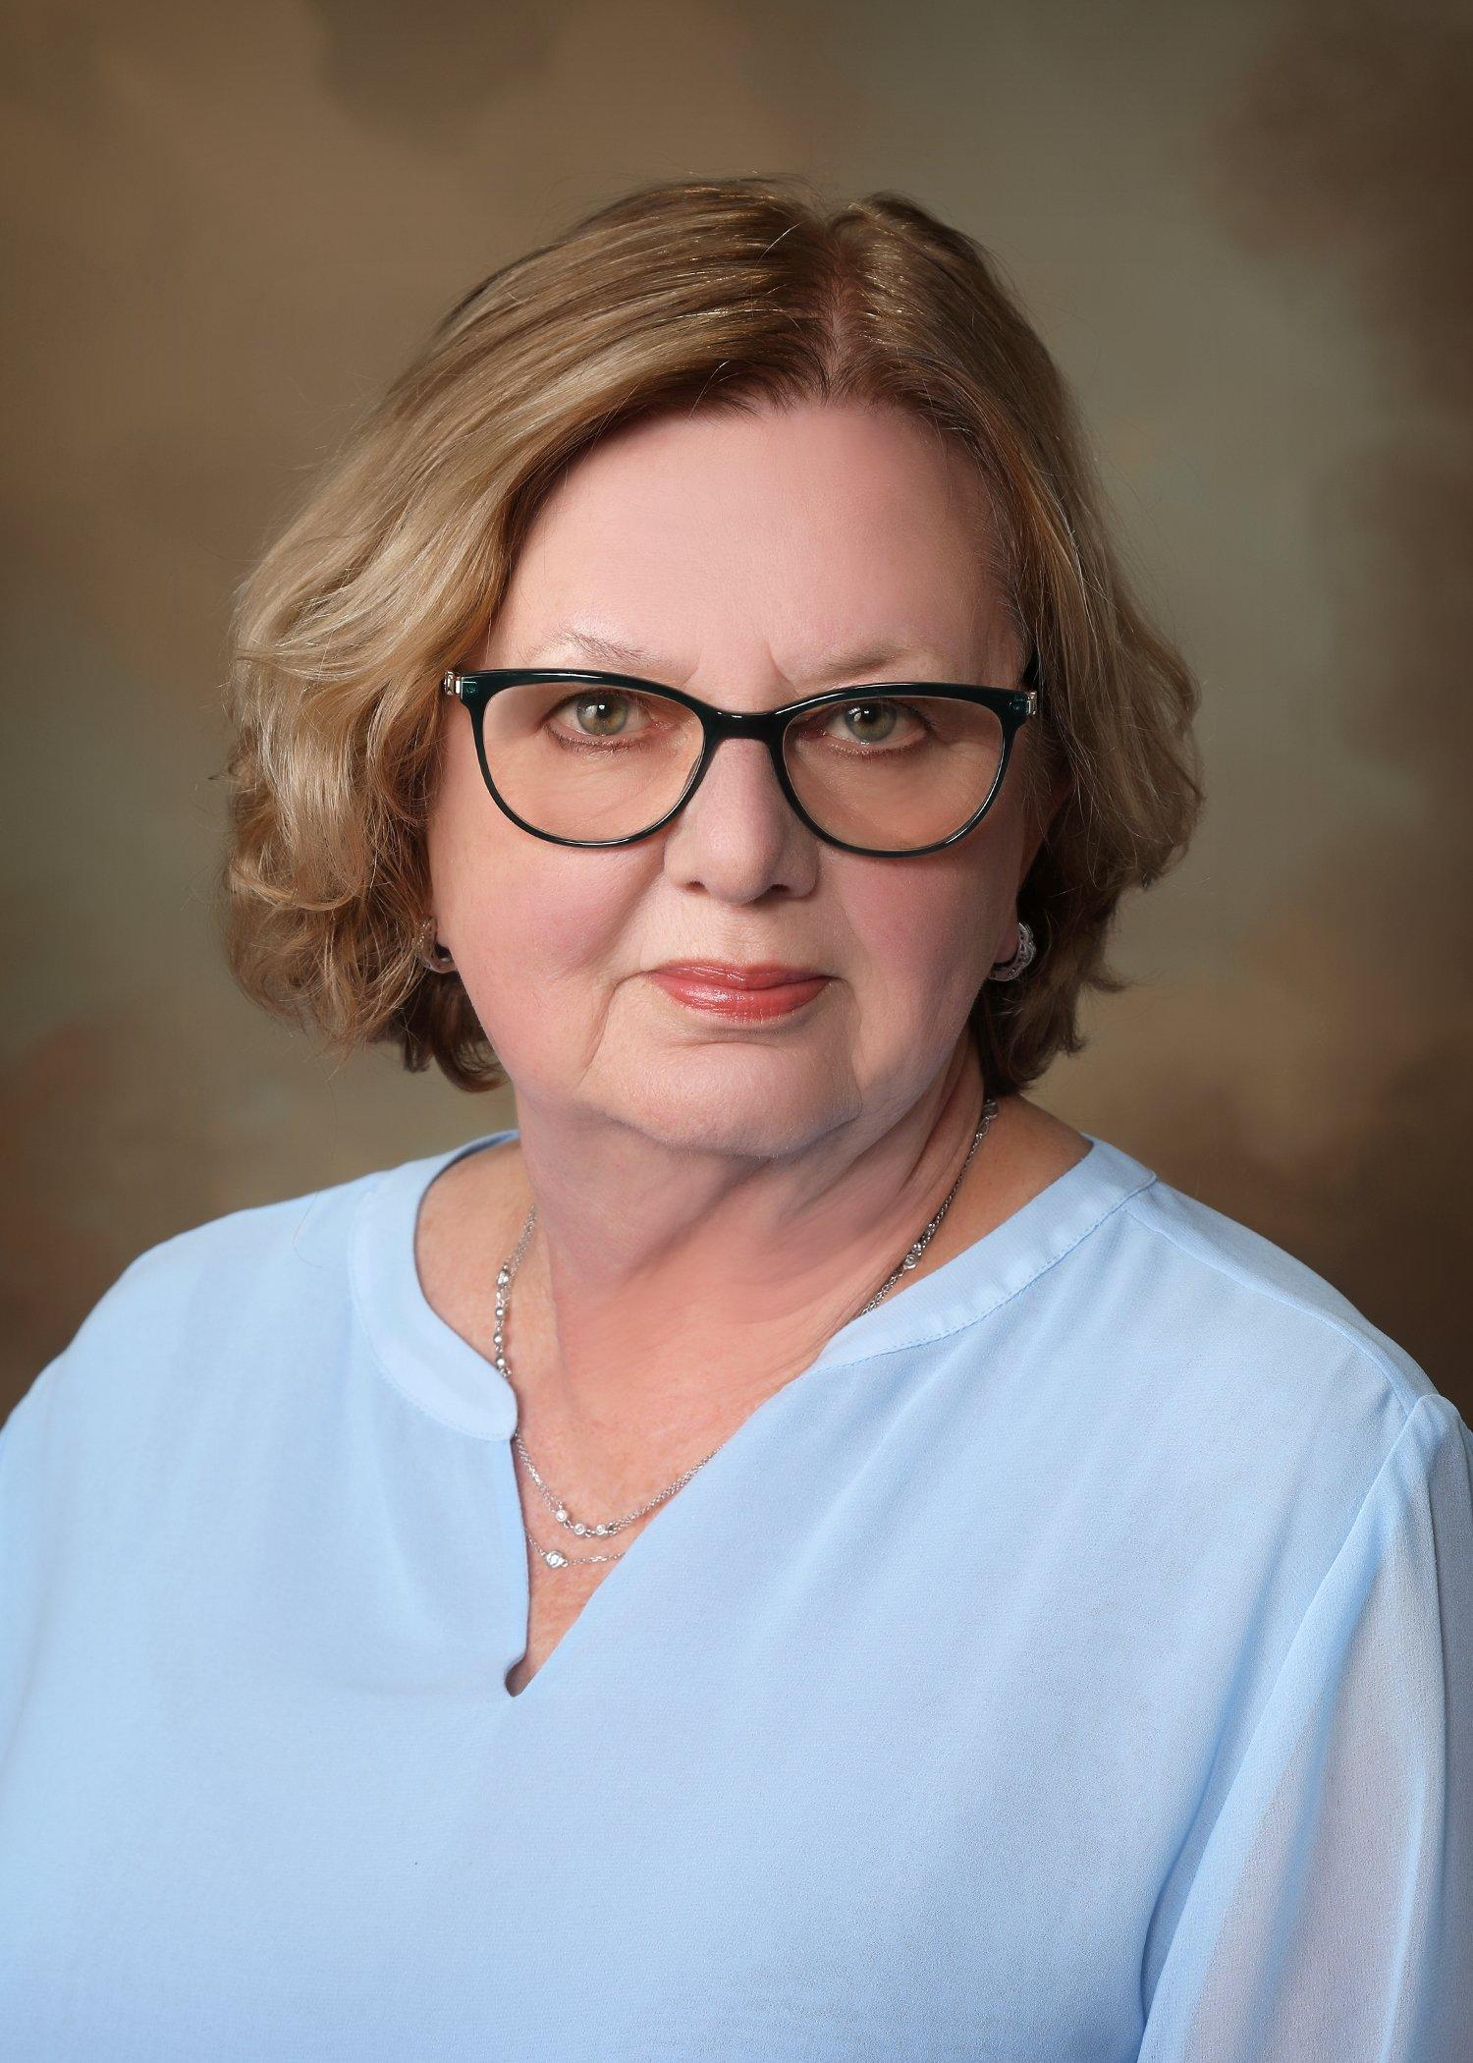
DEEP SOUTH GARDEN CLUBS
2024 ANNUAL CONVENTION
Debby Cooper,
DSGC Director
“Springtime in the Smokies” Park Vista Hotel, Gatlinburg, TN
March 19-20, 2024
Full registrations $245, Tri-refresher fees are $15 each
2023-2025 DSGC Theme: “Decorate the Deep South with Floral Design”

Slide 21
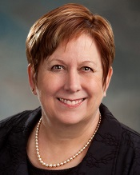
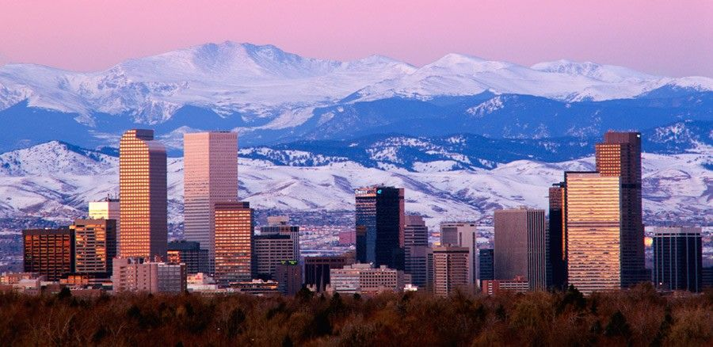
NATIONAL GARDEN CLUBS, Inc.
2024 CONVENTION
DENVER, CO
NGC HQ in St. Louis, MO
June 1-5, 2025
Westin Winchester Hotel, Denver, CO
Come meet NGC President, Brenda Moore!
2023-2025 Theme: “Go Green-Plant America”:
Plant America-Feed America
Plant America-Landscape for Wildlife
Plant America-Plant for Pollinators

Slide 22
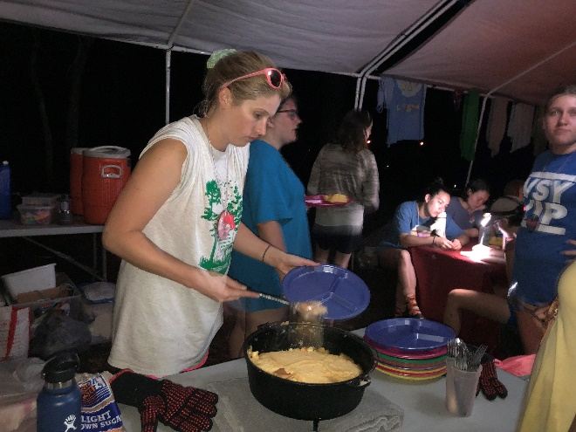
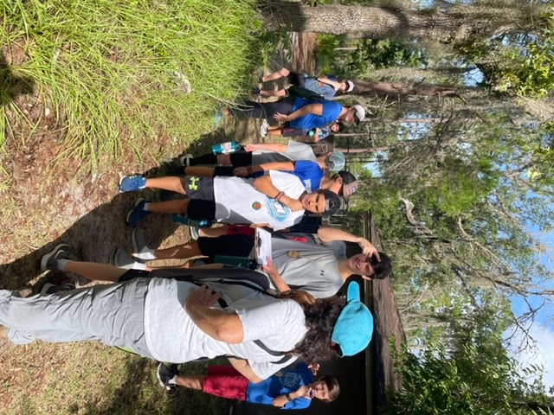
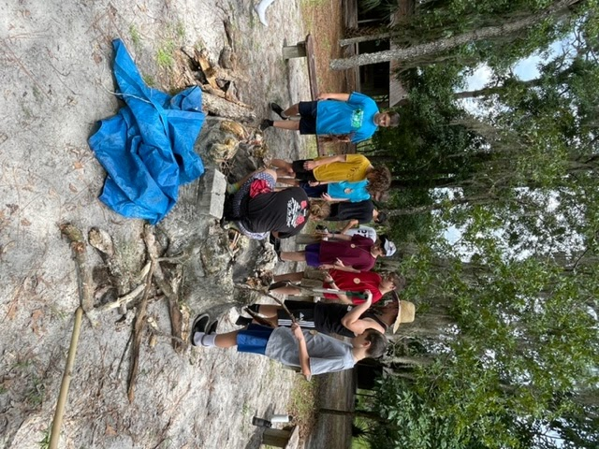
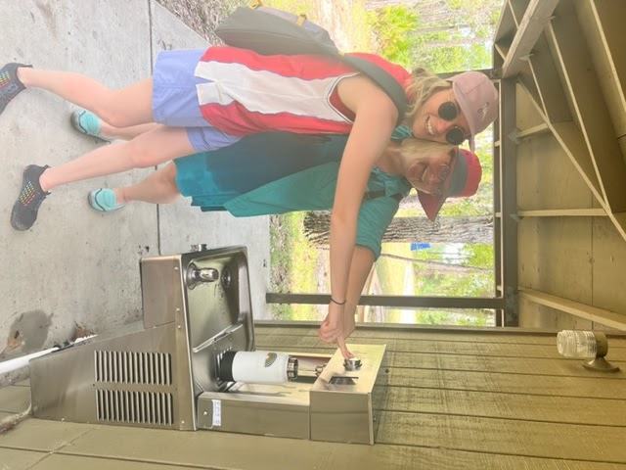
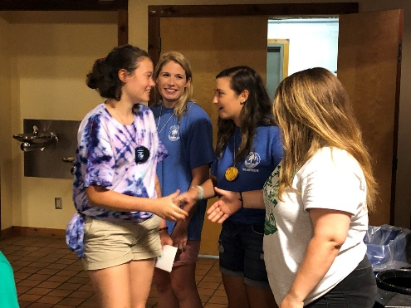
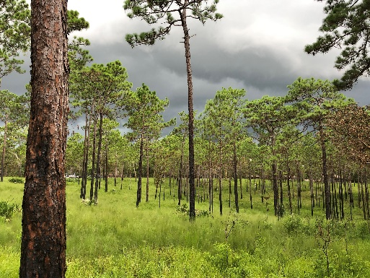
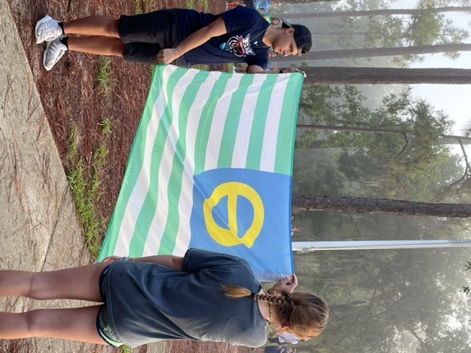
WEKIVA YOUTH CAMP
2024 curriculum: Trees!
Staggered Registration begins 8 pm,
January 2, 2024.
Volunteers, especially nurses, are needed!
Notes:
Mary

Slide 23
WEKIVA YOUTH CAMP
Notes:
Mary

Slide 24
2024 WEKIVA SCHEDULE
Notes:
Mary

Slide 25
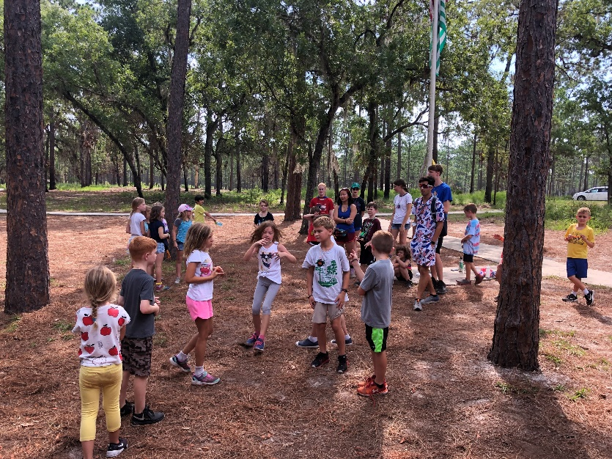
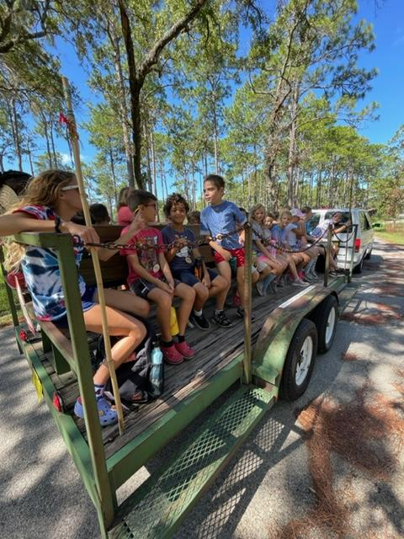
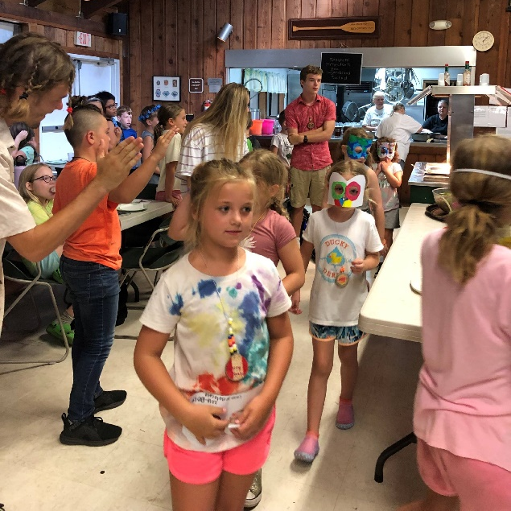
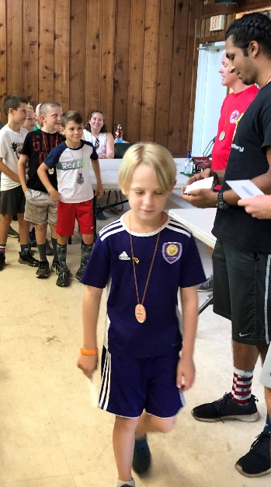
WYC CRITTER CAMP
For campers having finished 1^{st /}2nd grade.
Limited to 32 campers.
Dates: 9-11 July 2024 (during week 4)
Crafts, Nature, and Swimming
Registration begins 8pm, 2 January 2024
Notes:
Leticia

Slide 26
Sponsored by a Garden Club:
Registration 240.00
Activity Fee 35.00
Processing Fee 5.00
TOTAL FEE $280.00
Camper Child/Grandchild with Volunteer
Registration 135.00
Activity Fee 35.00
Processing Fee 5.00
TOTAL FEE $175.00
Camper Not Sponsored by a Garden Club:
Registration 340.00
Activity Fee 35.00
Processing Fee 5.00
TOTAL FEE $380.00
CAMP FEES
Notes:
Mary

Slide 27
Waterfront
Baby CPR Manikins $525 for 4
Air purifier for Clinic/Office $275
Adult CPR Manikins $454 for 4
Sponsorship of the Waldo Photo app $300 per year
AED Trainer $115
Backboard $200
Leaders in Training (LIT)
Holiday Coach Lines (bus to/from Marine Science Station $2,020-budgeted)
Primitive
Tents (2) $200 each
Sealing for tents - $150
Crafts
Tote Bag (50 pack) Reusable
Shopping Bags ($20 ea. X 12 packs
Name tags $100 (budgeted)
Nature
Digital cameras $100 each
Journal markers $250
Clinic
Littman Stethoscope $160 Pulse Oximeter $40
AED replacement pads $65 Tray table with wheels $100
Over-the counter medications (each summer) $225
AED battery (summer 2025) $250
Kitchen
Cook and Hold Oven $9,500 Drink dispenser $1,371
Hot/cold wells for food service $4,500
Griddle $500
Additional Plates, bowls, cups, ladles $500
CAMP WISH LIST
Notes:
Mary

Slide 28
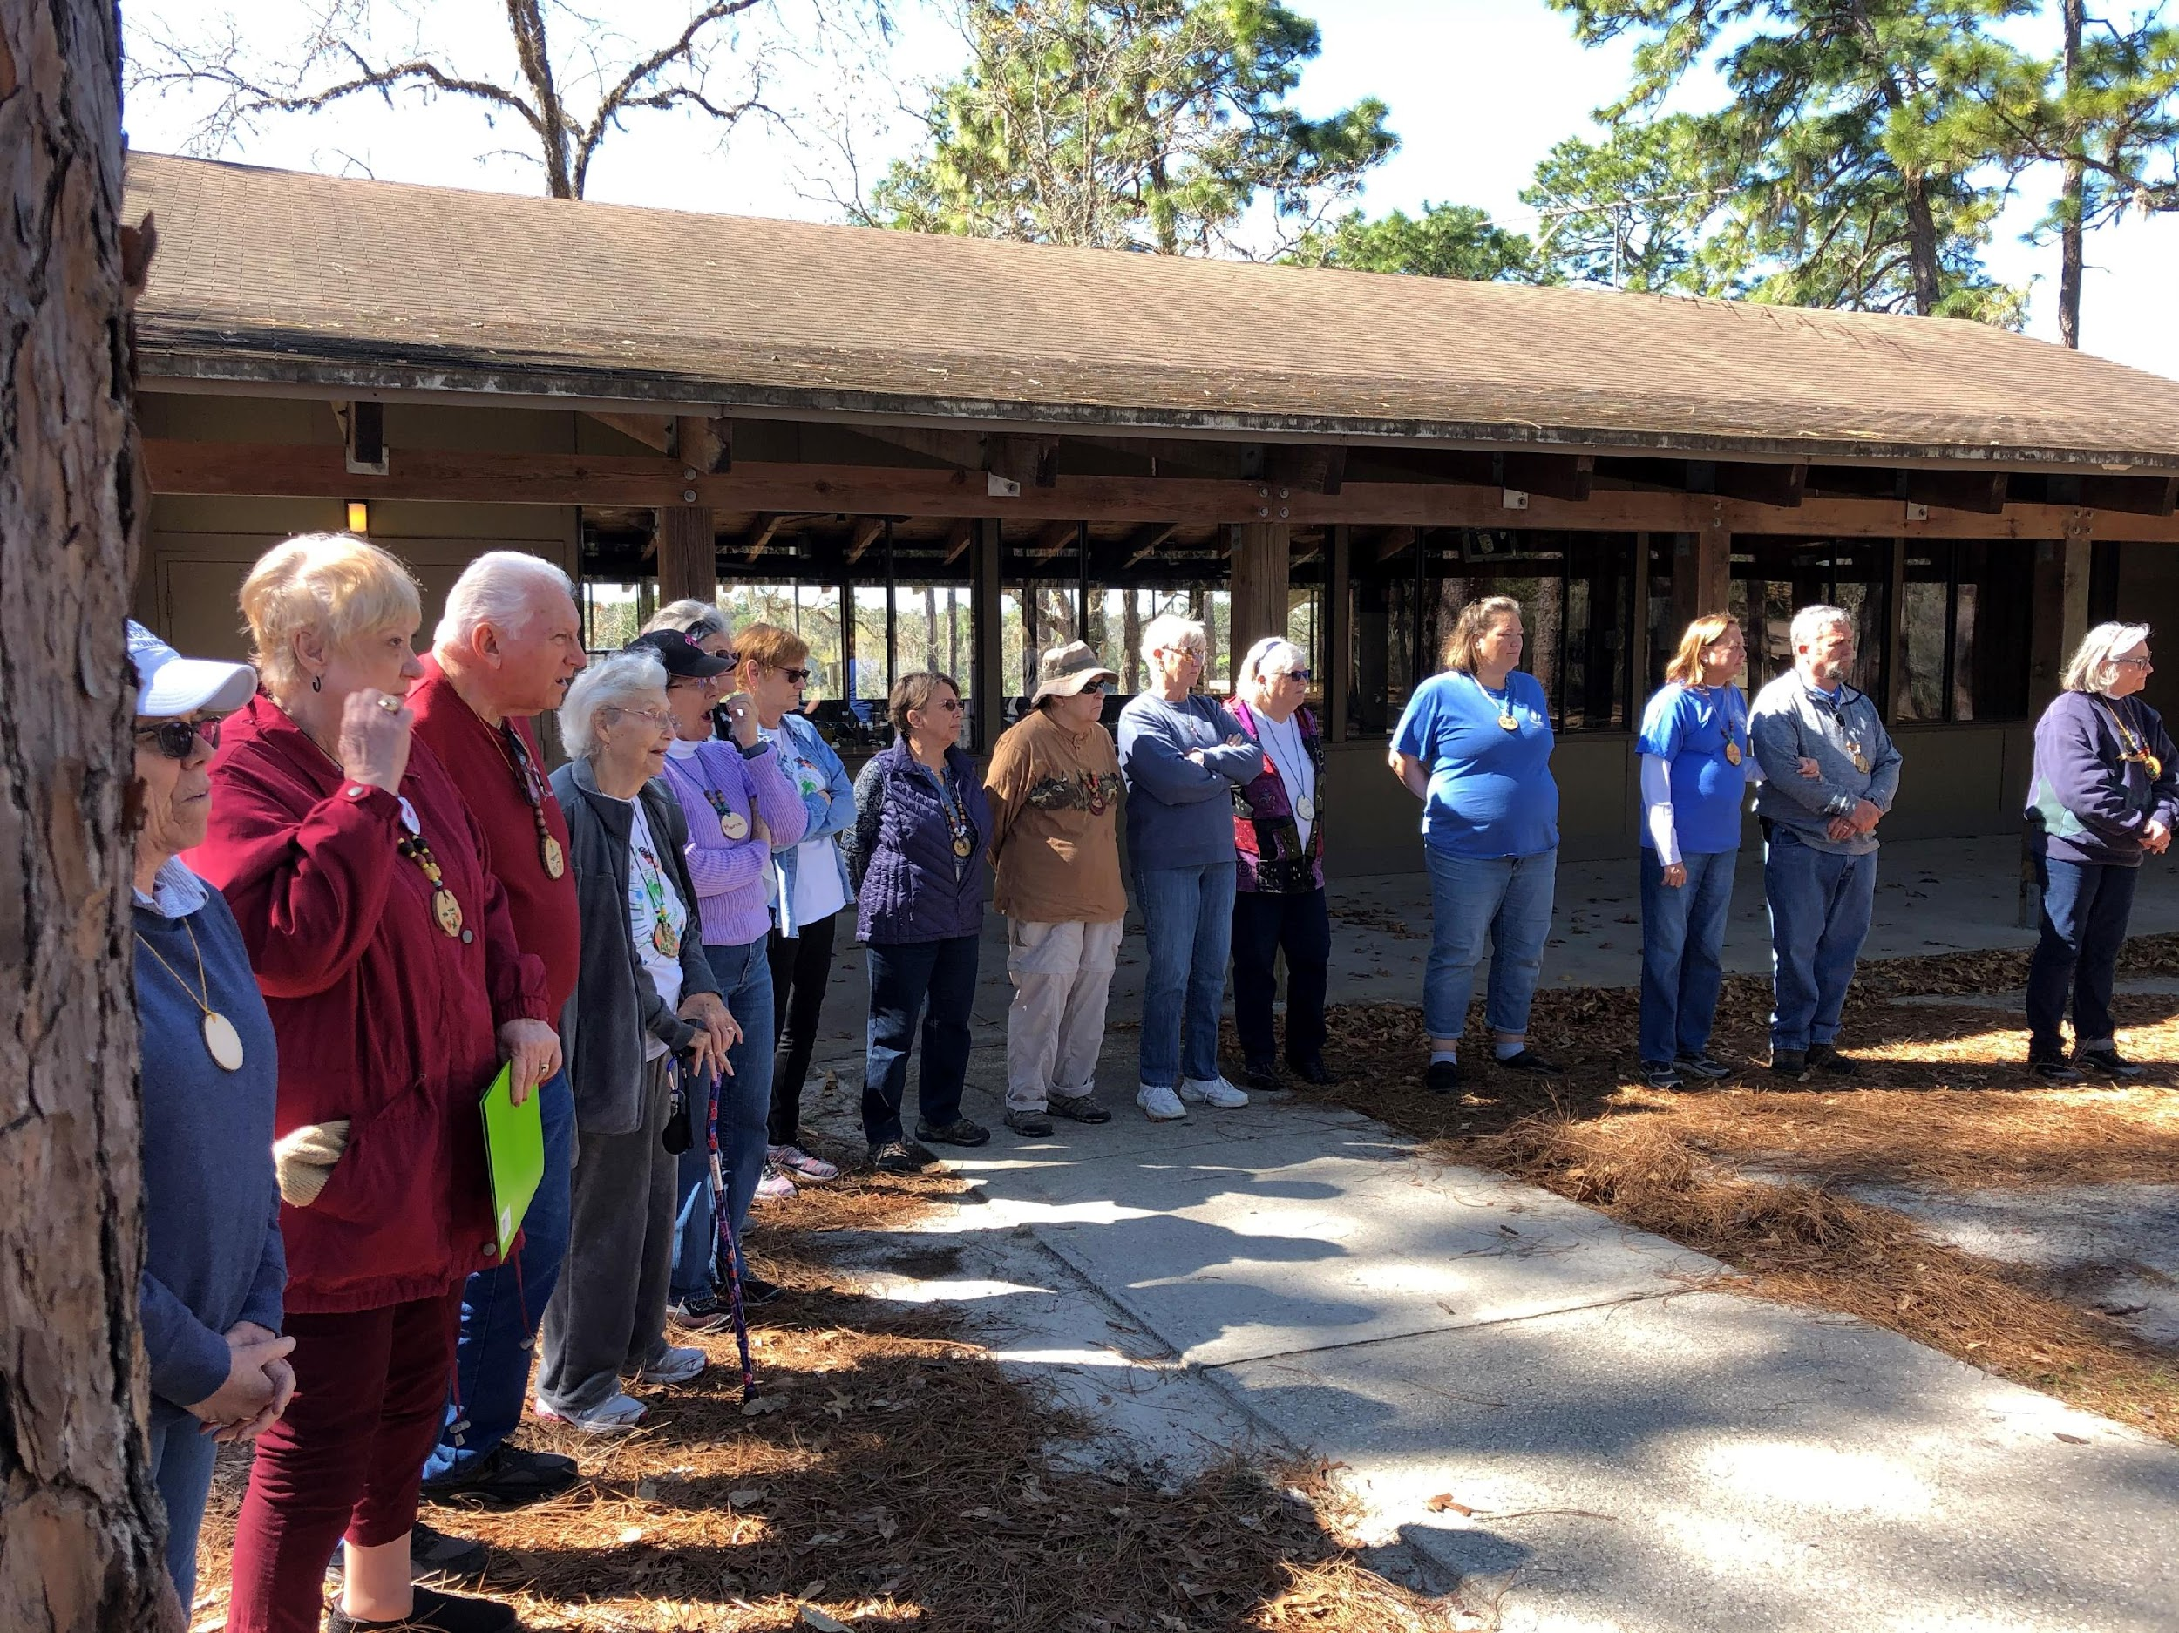
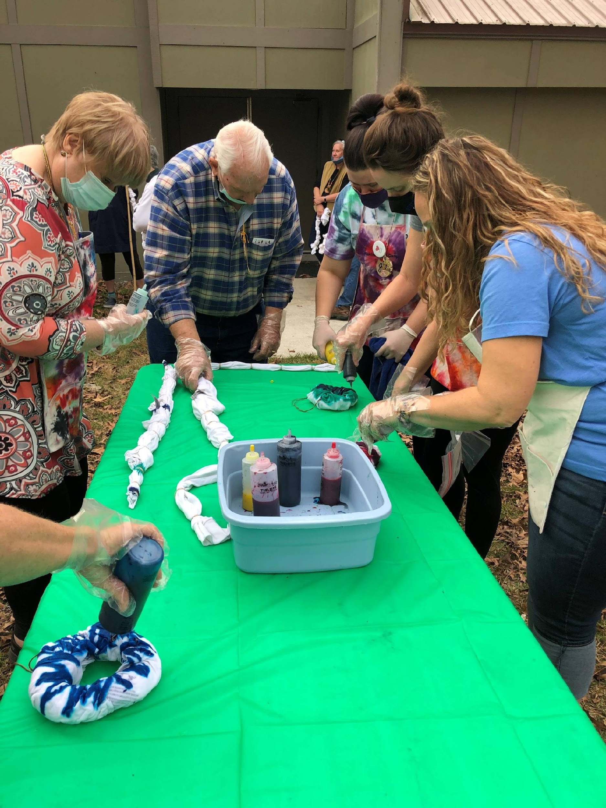
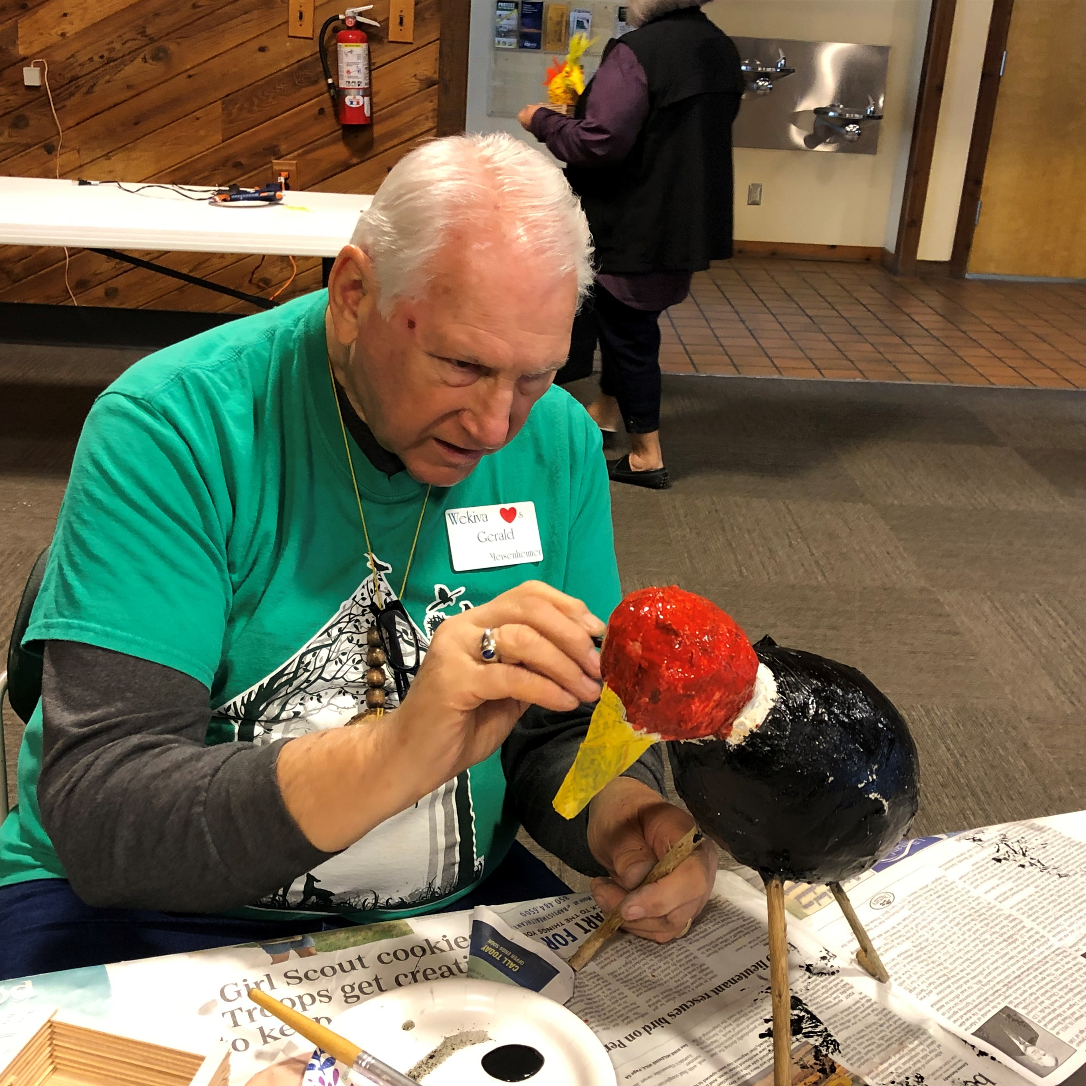
VOLUNTEER TRAINING & JUNIOR GARDENER LEADING TRAINING
SAVE THE DATE! FEBRUARY 10-12, 2024
Come experience the camp and learn how to assist WYC staff in crafts and nature sessions.
Take home information to share with your Junior Gardeners!
FORM: https://www.ffgc.org/Wekiva-Youth-Camp.
Notes:
Leticia

Slide 29
This Volunteer Training form is
available online.
Cost is $75.
https://www.ffgc.org/Wekiva-Youth-Camp.
Notes:
Leticia

Slide 30
Notes:
Leticia

Slide 31
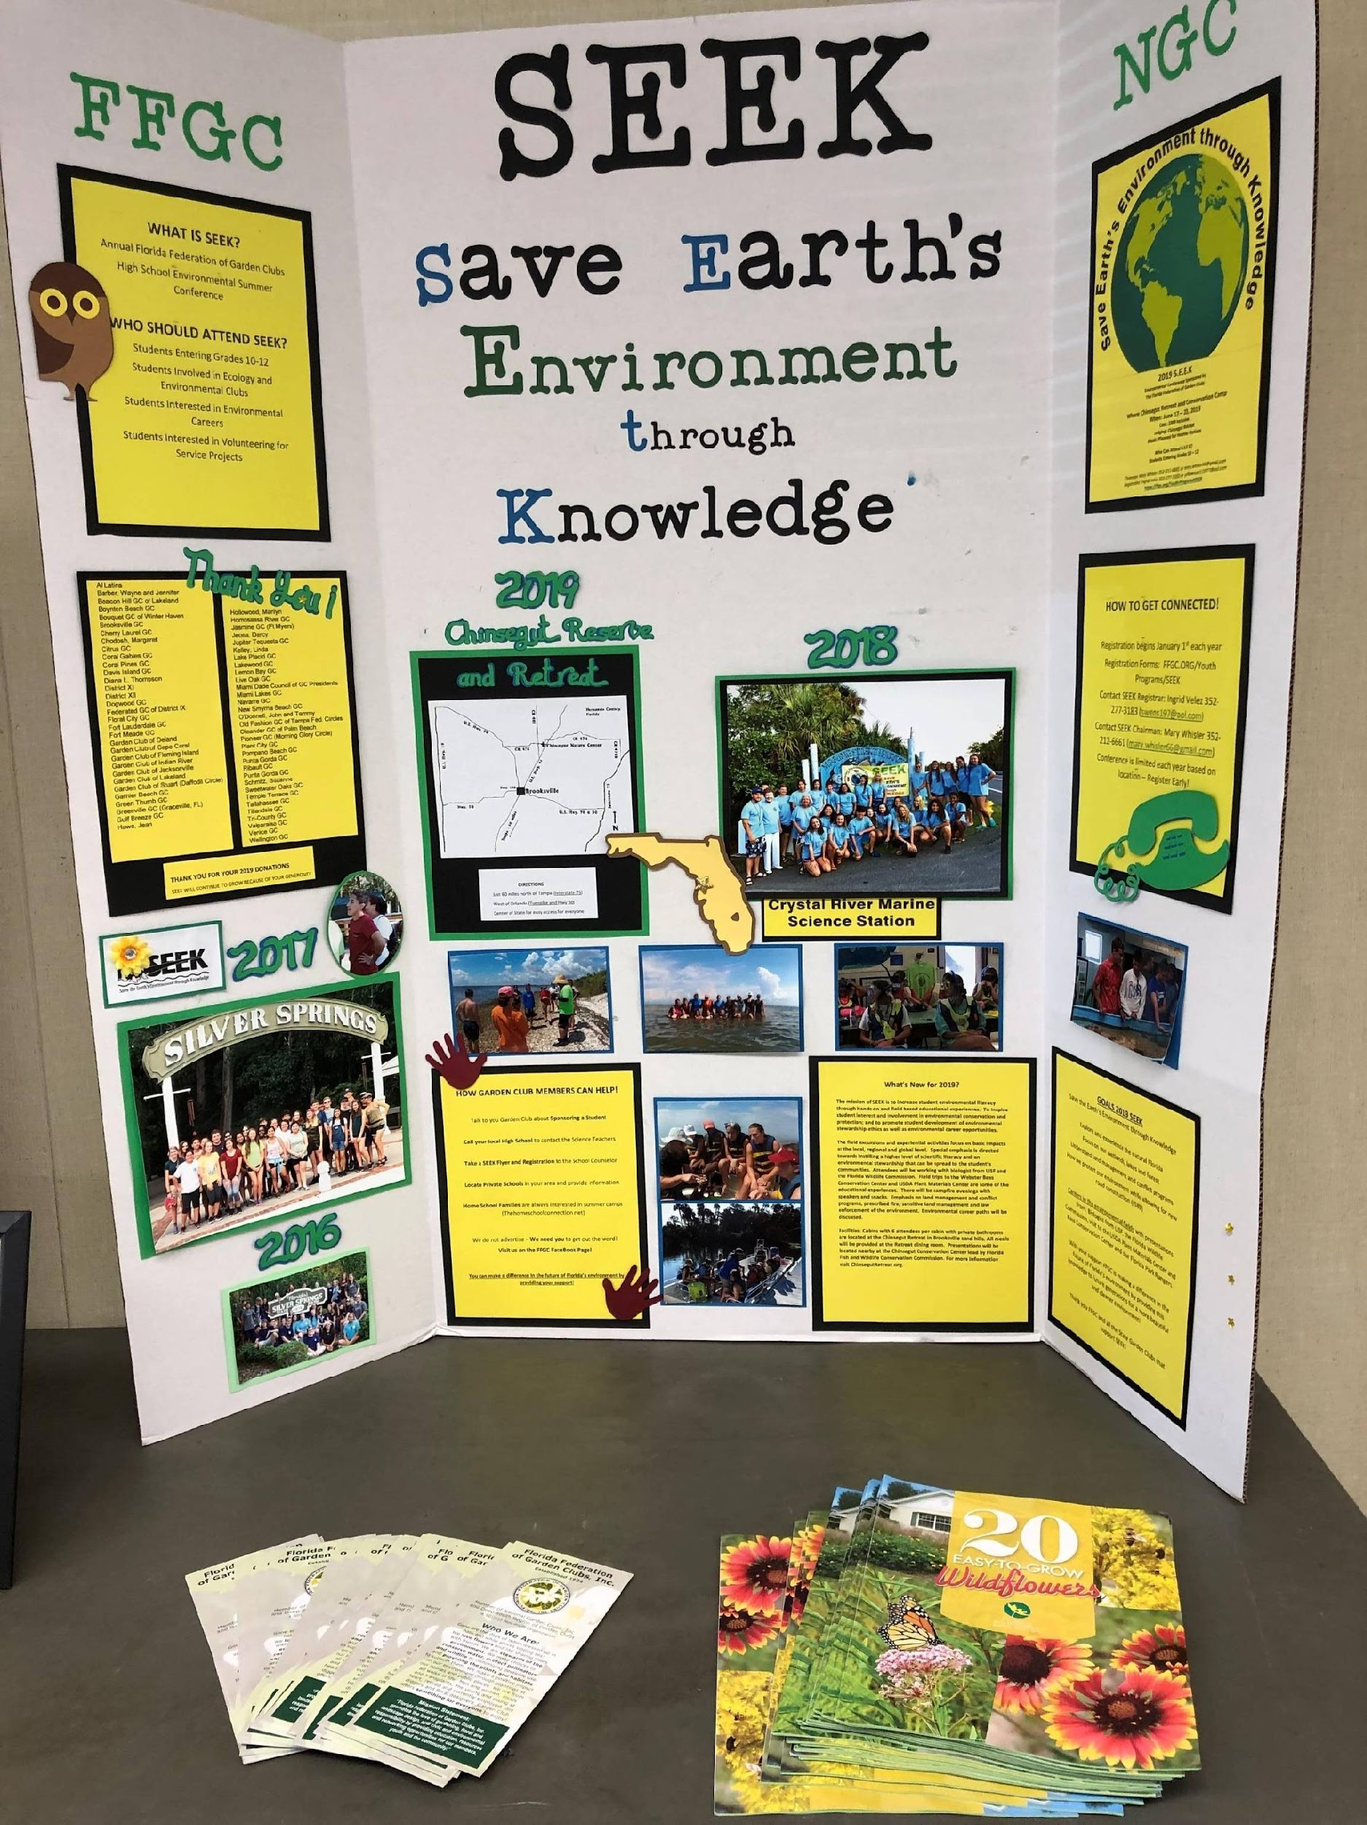
S.E.E.K. 2024
Location: UF, Gainesville
Dates: Sunday, June 9 to
Wednesday, June 12
Theme: “Our Natural World”
Sponsored by Florida Wildflower Society, our affiliate.
SEEK 2024 -- 50 students, with returning from SEEK 2023.
FFGC.org/SEEK for updates
Email: SeekConferenceReg@gmail.com
Notes:
Mary

Slide 32
SCHOLARSHIPS
CONGRATULATIONS F.F.G.C.
SCHOLARSHIP RECIPIENTS
2022-2023
Ailee Odom
Cassie Valenti
Caroline Gordon
Miller Maddox
Cayla Smith
Madison Ryan
FFGC Scholarship Chairman,
Helen Purvis
NGC/DSGC Sch. Chrm.,
Mary Adams
F.F.G.C. Scholarships
Applications due 1 May.
DSGC Adv. Scholarships =2 given, $3,500 each
NGC Scholarships = 43 given, $4,000 each
NGC and DSGC applications due 1 February.
In-house and club scholarships!
$30K/yr

Slide 33
AILEE ODOM

Slide 34
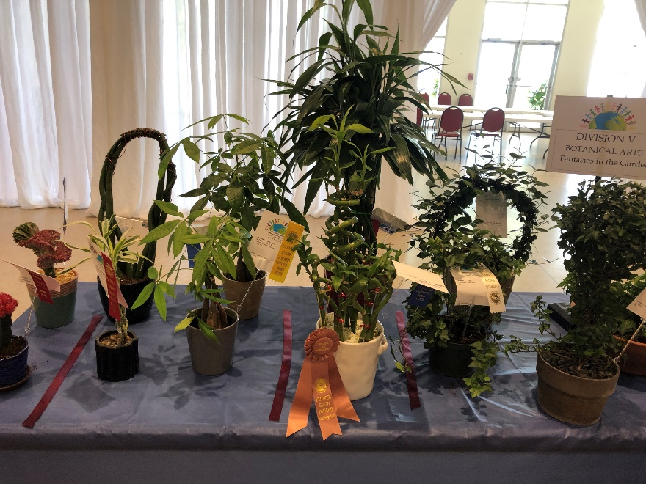
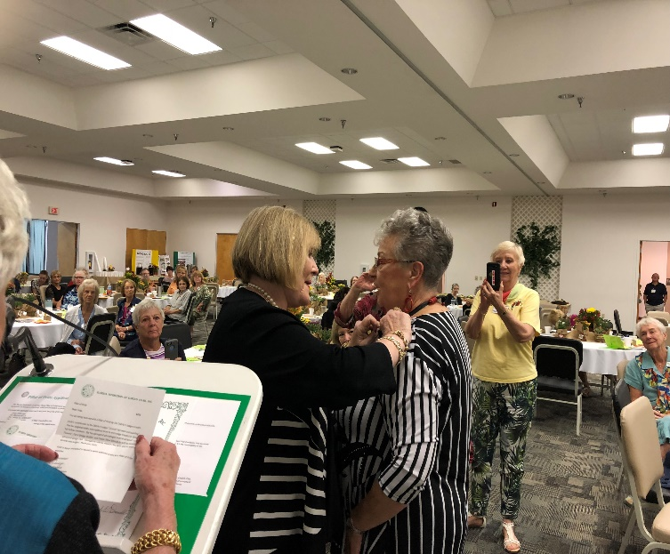
EDUCATIONAL OPPORTUNITIES
Flower Show Schools and Symposia (NGC/FFSJ))
Environmental Schools (NGC/Tri-Council)
Gardening Schools (NGC/Tri-Council)
Landscape Design Schools (NGC/
Tri-Council)

Slide 35
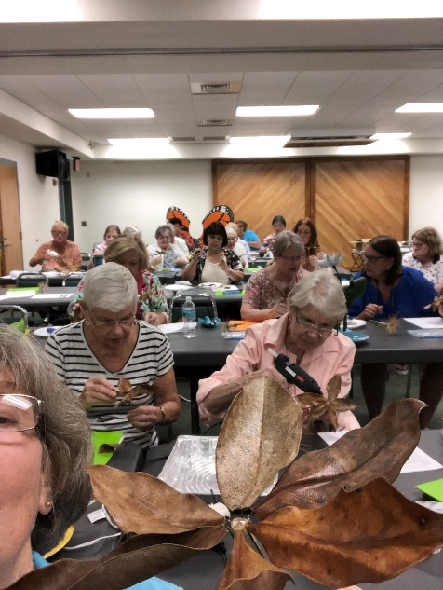
FFGC EDUCATIONAL OPPORTUNITIES
Floral Design Study Series (FFGC)
“Digging It” Horticulture Study Series (FFGC)
“Fun with Flowers” (FFGC)
Short Courses (FFGC):
Tropical Short Course: Wellington, 25-26 January 2024
UF/FFGC Short Course: Gainesville, 3-4 June 2024
Short Course North: Milton
8-9 August 2024
Wekiva Volunteer Training:
Apopka, 10-12 February 2024

Slide 36
Notes:
We have SOLD OUT one complete group and are working on a second group. When it sells out – that’s it. So, book while there is still space.

Slide 37
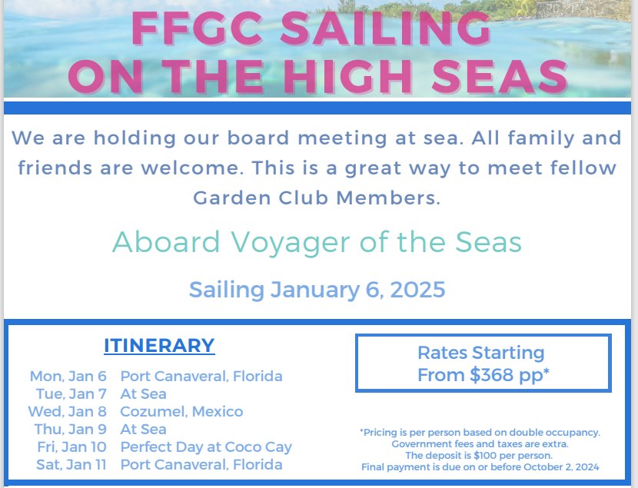
Notes:
Tina --The January 2025 FFGC Board Meeting will be held on a ship sailing out of Pt Canaveral. There are about 30 already booked on this and we have special pricing right now.

Slide 38
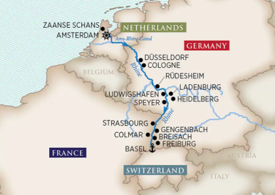
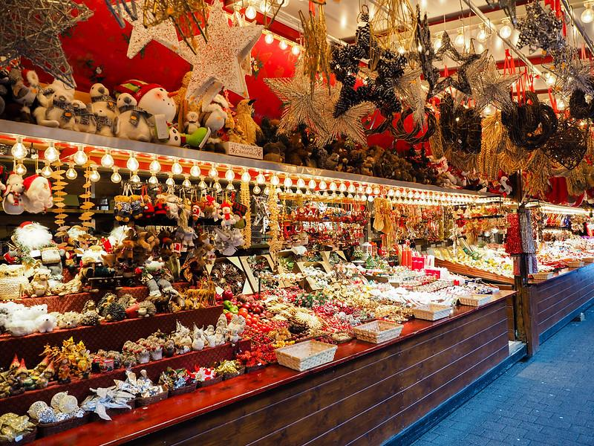
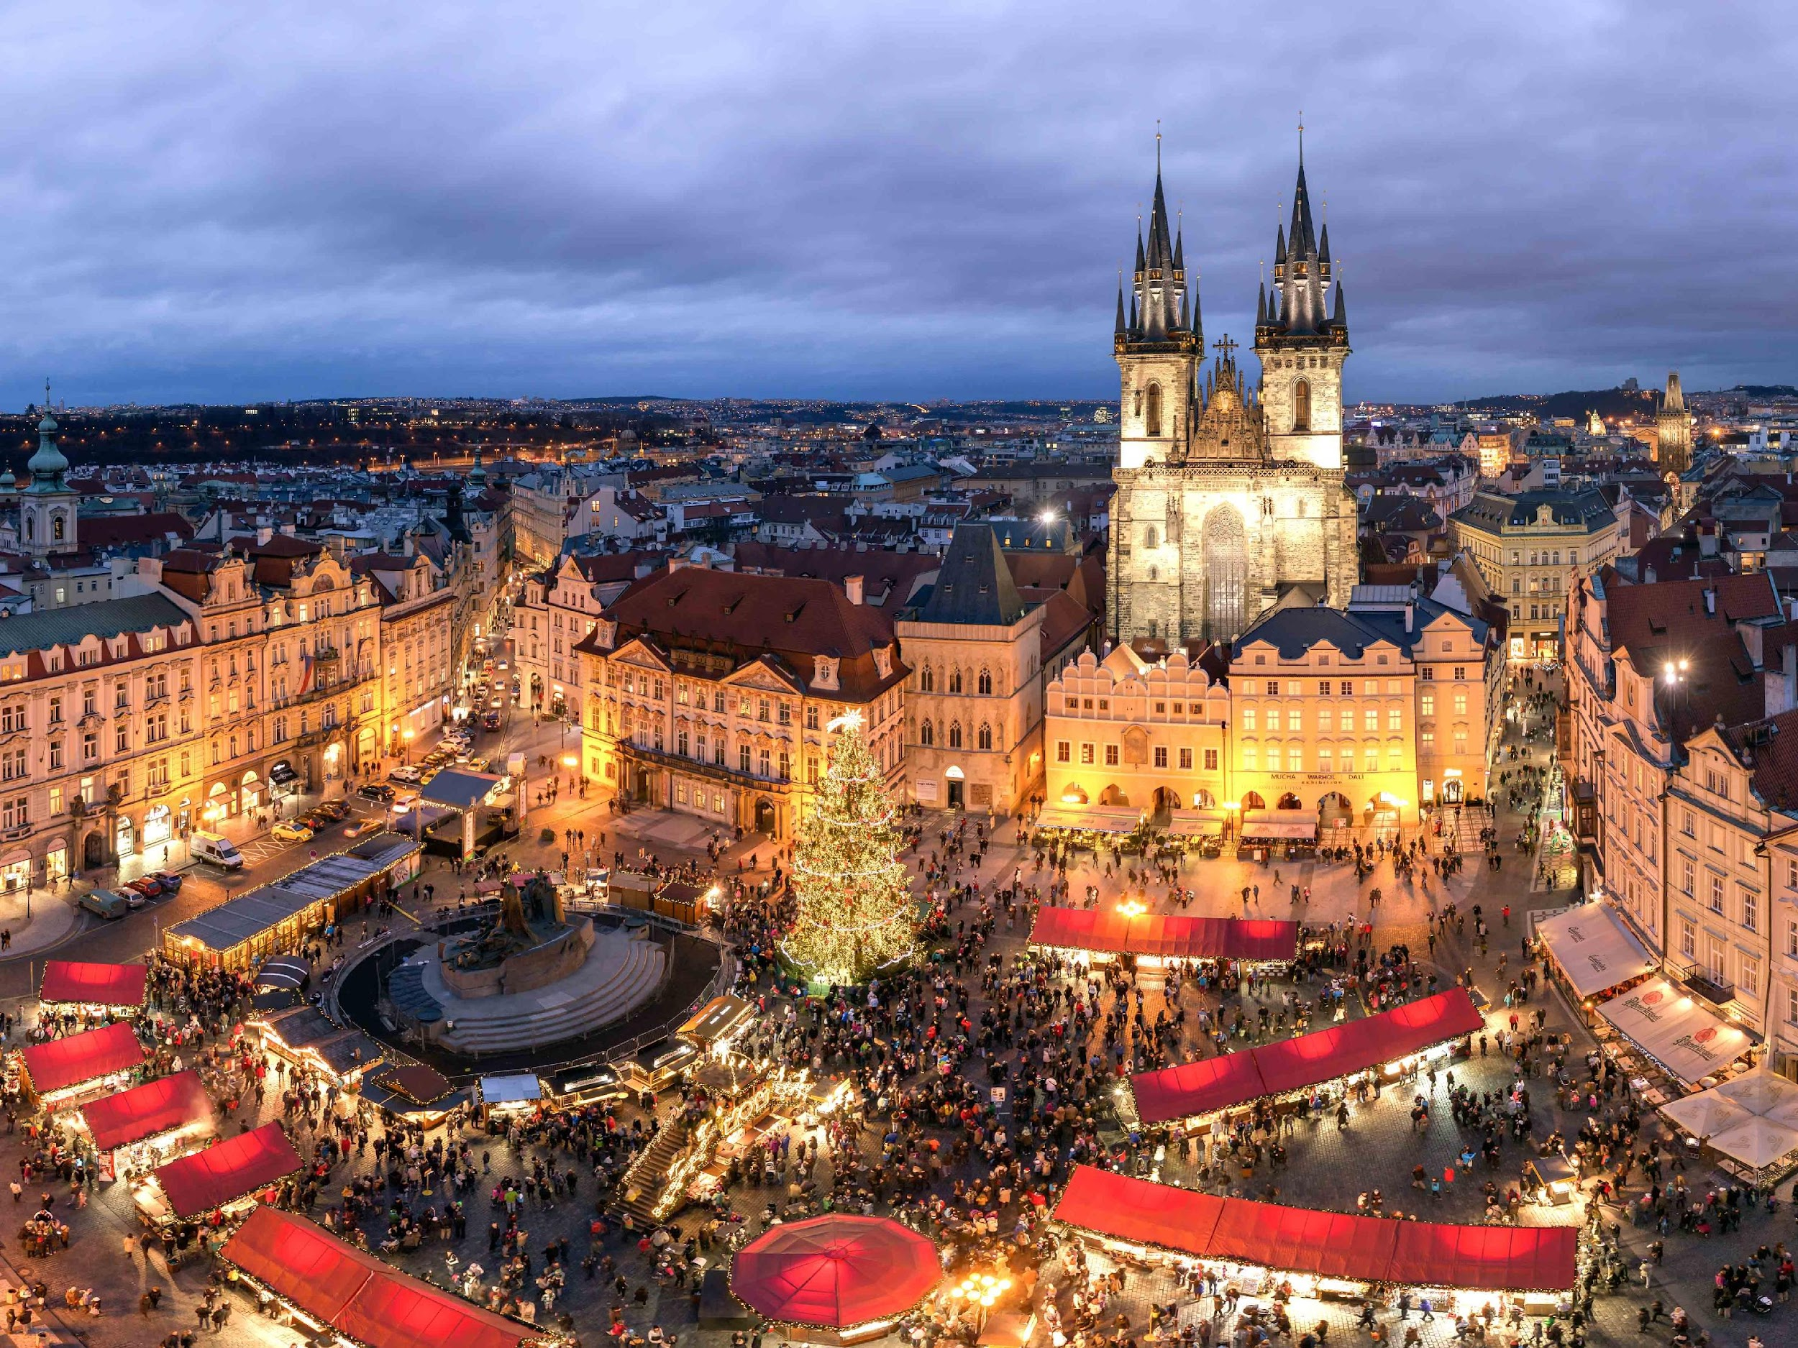
Notes:
Many of you have suggested we do a Christmas Markets River Cruise, so here it is. Sailing from Switzerland to Amsterdam on the Rhine River. Special savings if booked this year - $500 OFF per person.

Slide 39
FEBRUARY 2027
Sign up to learn more later on.
Notes:
World Association of Floral Artists International Show in Australia in February 2027. This will be combined with either a cruise or land tour in Australia and/or New Zealand. It’s all still under development, but if you want to be the “first to know” as we develop it, get your name on the email list for this trip and we’ll make sure to keep you “up to date”.

Slide 40
(850) 386-7327
ext. 208
Satkinson@FunSeas.com
www.FunSeas.com/FFGC
Notes:
To learn more on any of these trips or sign up to get emails on FFGC travel, Call, Email or go to the Website OR Scan this QR Code

Slide 41
Contributions to the Centennial Celebration? FFGC.org/donate
Quilt Block kits due NOW!
So many planned events…
January 19, 2024 Arbor Day Planting
April 24, 2024 Brunch and Dinner
January 6-11, 2025 Cruise
Notes:
Tina

Slide 42
CALENDAR OF EVENTS
Contact our Corresponding Secretary, Linda Johnson, to ensure your date doesn’t overlap with another FFGC event. She will enter your event on the website.
Complete the Calendar Submission Form (FORMS) Form to Submit a Calendar Entry with Event Name, Date, Time, & Location

Slide 43
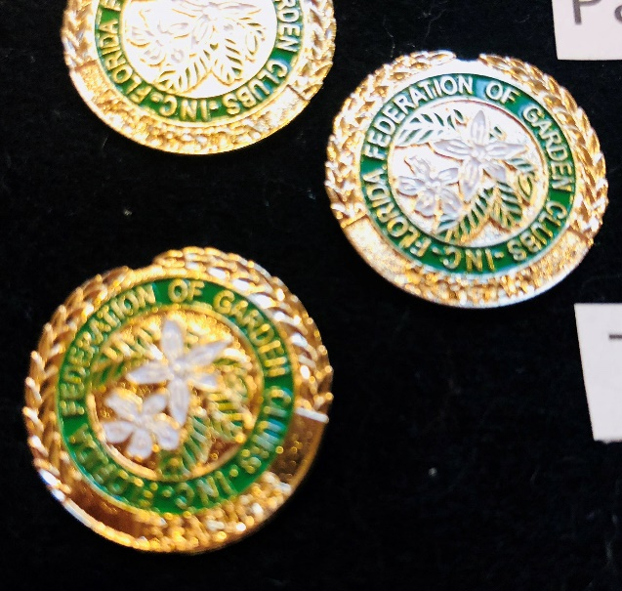
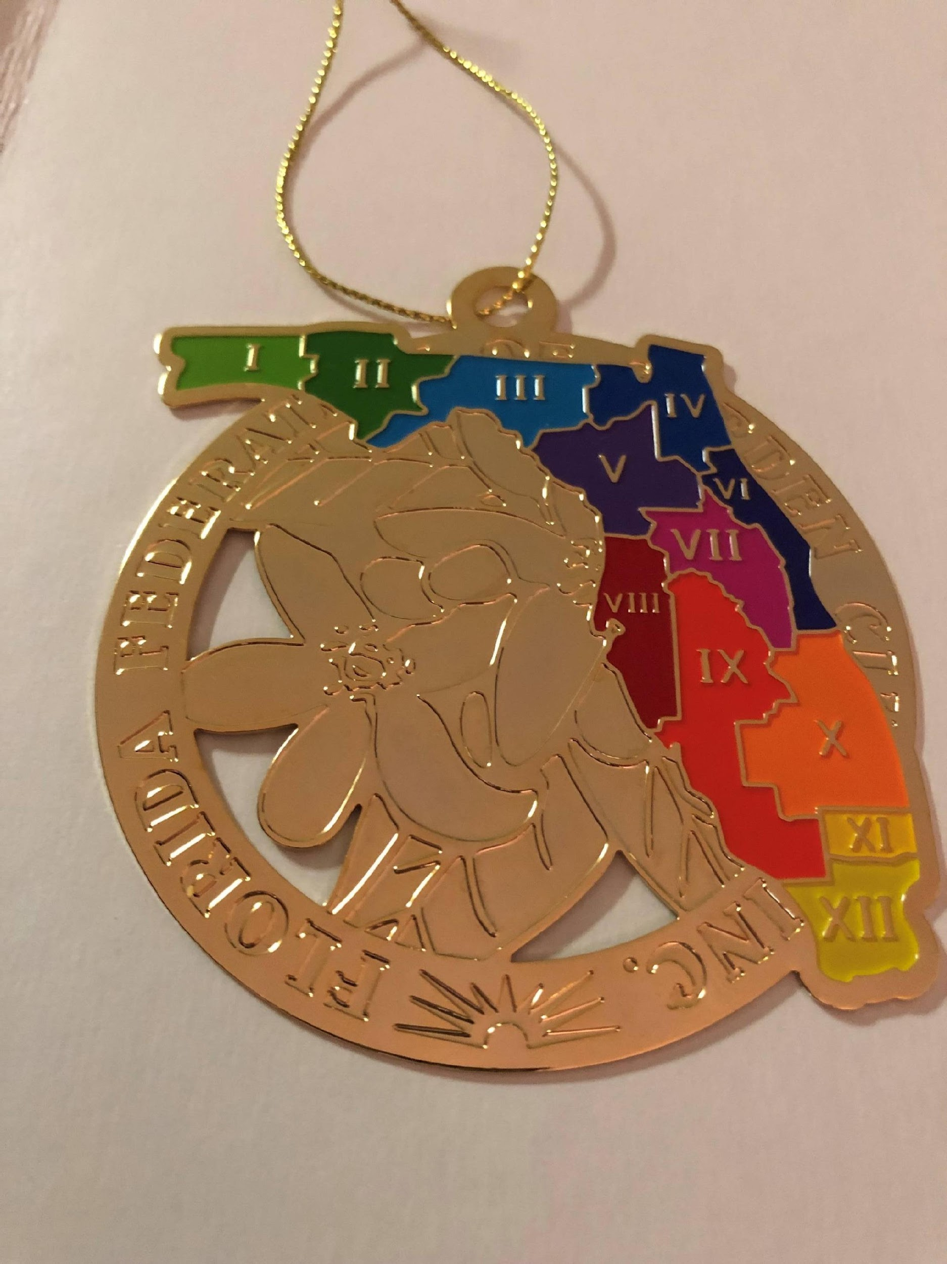
WAYS & MEANS
These items and more are available from the FFGC Gift Shop at HQ. Order online.
Bars & Pins: $7/$12 each
2024 Commemorative Calendars, 100th logo pins, 100th and state logo ornaments: $10 each
T-shirts and more!
Notes:
Leticia

Slide 44
OUR SINCERE THANKS TO ALL
Thanks to all who serve on the FFGC Board of Directors and various committees.
Thanks to all who submitted Awards/Grants.
Thanks to all who volunteered at or donated to Wekiva Youth Camp, SEEK and our scholarships.
Thanks to all who serve at the District level.
Thanks to all who serve in your clubs and circles.
Thank you everyone for your continued participation, membership and support of FFGC!

